Slide 1

Overview of ISPOR
SECTION
1

Slide 2



Celebrating 30 Years of ISPOR…

Slide 3


Slide 4



Slide 5


Slide 6


Slide 7
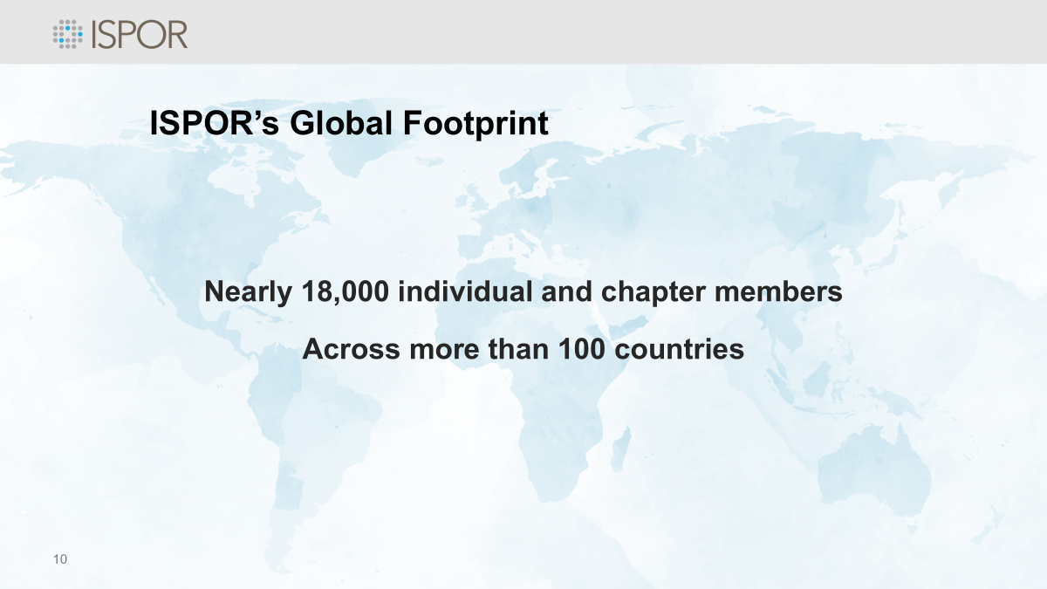
20,000
ISPOR Members
Worldwide

Slide 8
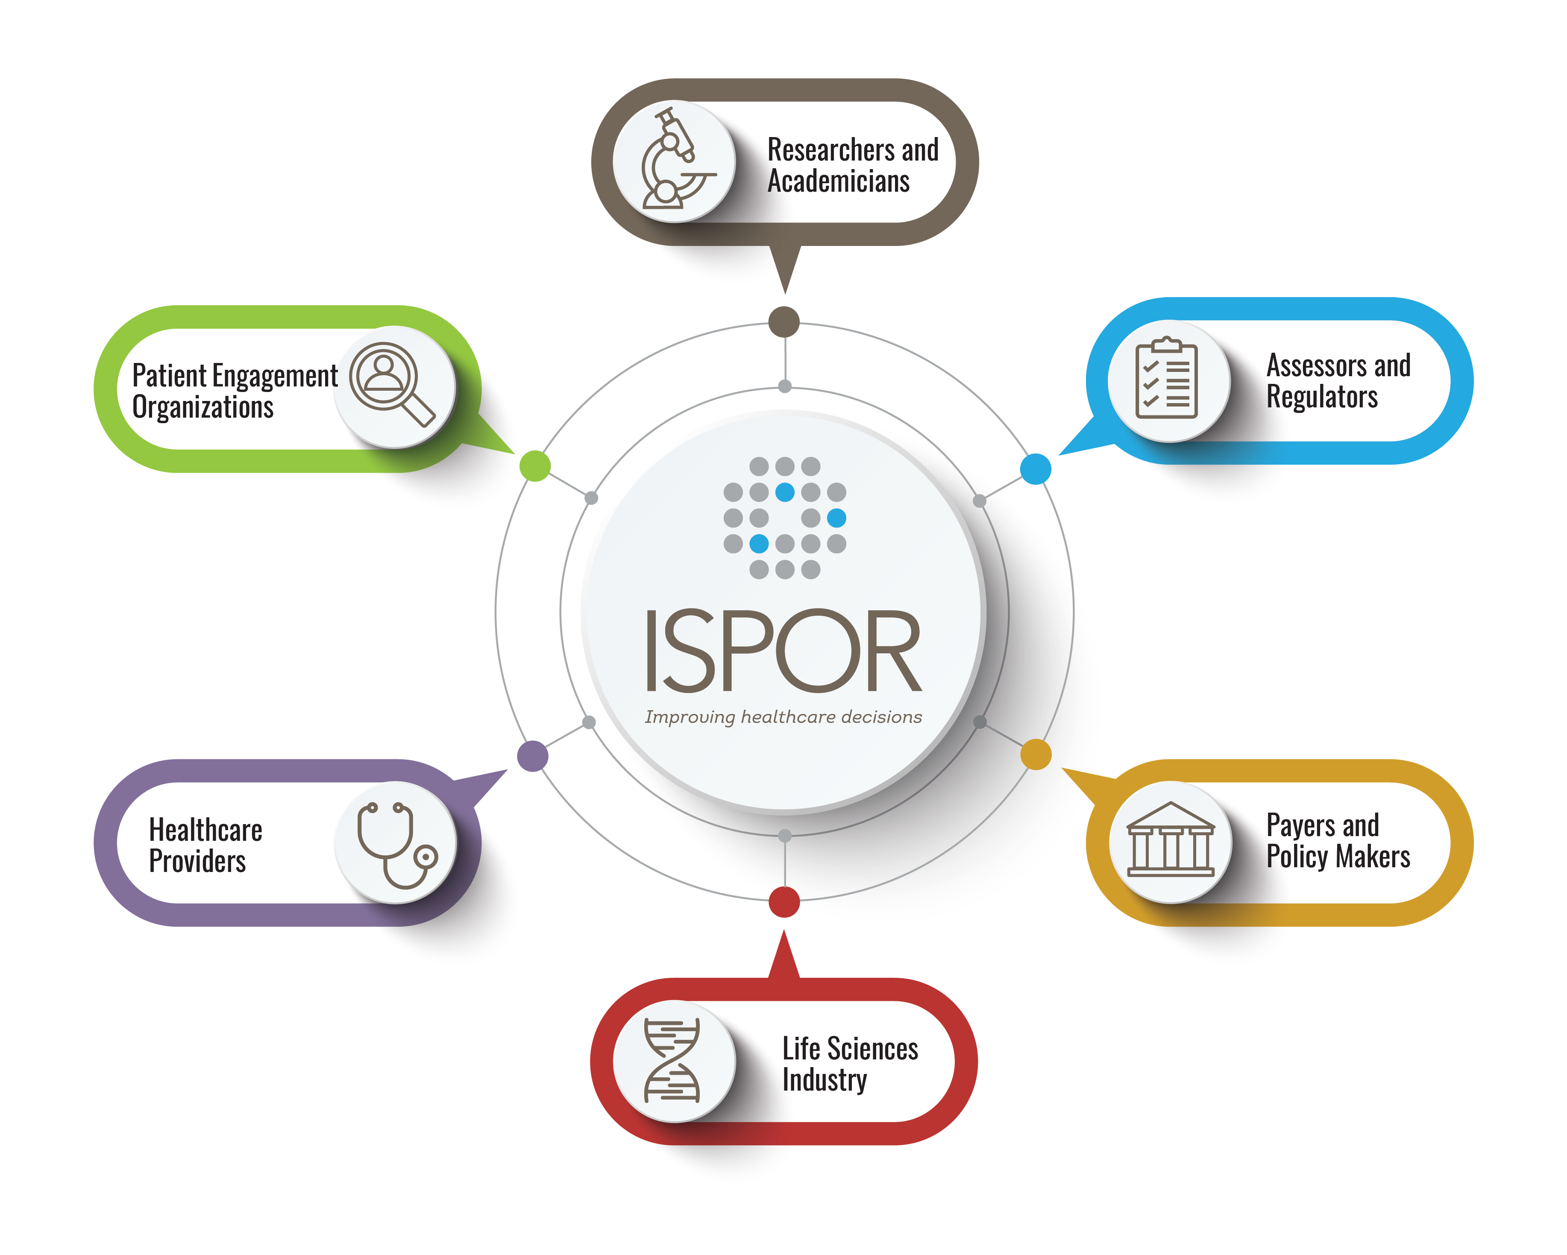
ISPOR Stakeholders
ISPOR is a nonprofit organization that welcomes all healthcare stakeholders as members.

Slide 9
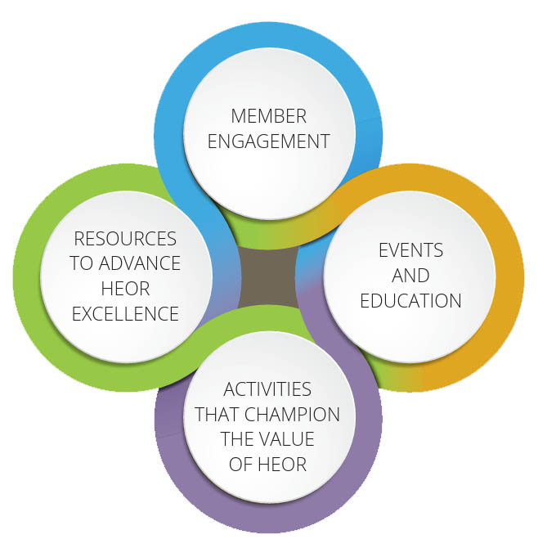
Our Foundation
ISPOR’s strategic plan focuses on strategy and goals based on a strong operational foundation.

Slide 10

ISPOR’s Board of Directors 2025-2026

Slide 11
About the ISPOR Student Network
SECTION
2

Slide 12


Student Network
ISPOR’s student membership program helps develop future leaders in health economics and outcomes research. Student membership offers:
  Student chapters
  Educational Zoom Meetings/Webinars
  Travel grants
  Awards
  Discounts on membership,
  and event registrations

Slide 13







Student Network Council 2025-2026
Zeba M. Khan, RPh, PhD
ISPOR Student Network Advisor
Email: zkhan@celgene.com
Dominique Seo, MPH
ISPOR Student Network Chair
University of Maryland, USA
Email: dseo@umaryland.edu
Ivy Leong, PhD, MS
ISPOR Student Network Chair-Elect
University of Mississippi, USA
Email: nleong@go.olemiss.edu
Kanya Shah, PharmD, MBA, MS
(PhD Candidate)
ISPOR Student Network Past-Chair
University of Illinois, USA
Email: Kshah233@uic.edu
Nancy Chen
ISPOR Staff Liaison
Director, Global Member Engagement
Email: nchen@ispor.org
Lynn Schindel
ISPOR Staff Liaison
Manager, Global Member Engagement
Email: lschindel@ispor.org
Kara Martin
ISPOR Staff Liaison
Coordinator, Global Member Engagement
Email: kmartin@ispor.org
Notes:
The Student Network Council also includes input from the 107 ISPOR Student Chapter Presidents representing 31 countries.

Slide 14
Faculty Advisor Council: Chair, Past Chair, Chair-Elect, Student Network Advisor, Faculty Advisors, Staff Liaisons
Student Committees:
Education, Event Planning, Publications, Survey & Evaluation
Student Chapters:
Africa, Asia-Pacific (Oceana), Central and Eastern Europe, Latin America, Middle East, North America (Canada), Western Europe
Student Council: Network Chair, Network Past Chair, Network Advisor, Chapter Presidents, Staff Liaisons
Student Network Organizational Structure
Our Mission

Slide 15
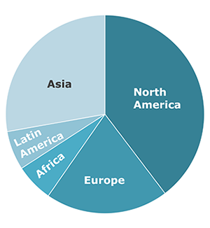
Student Network Demographics
Comprised of 1,500+ Student Members representing 70+ countries
Comprised of 90+ Student Chapters representing 30+ countries

Slide 16
Membership Benefits and Offerings
SECTION
3

Slide 17



ISPOR Membership
Member Benefits
World-class, global scientific conferences
MEDLINE®-indexed publications
HEOR resources and tools
Educational and training programs
Awards and recognition
Career development

Slide 18


Slide 19






ISPOR Essential HEOR Education
Learn. Apply. Advance.
Training Programs
Short Courses
Educational Webinars
Distance Learning

Slide 20



HEOR Learning Lab™
…provides unlimited, on-demand educational video content on a wide variety of HEOR topics to facilitate learning and innovative approaches in the field.
^{www.ispor.org/LearningLab}

Slide 21
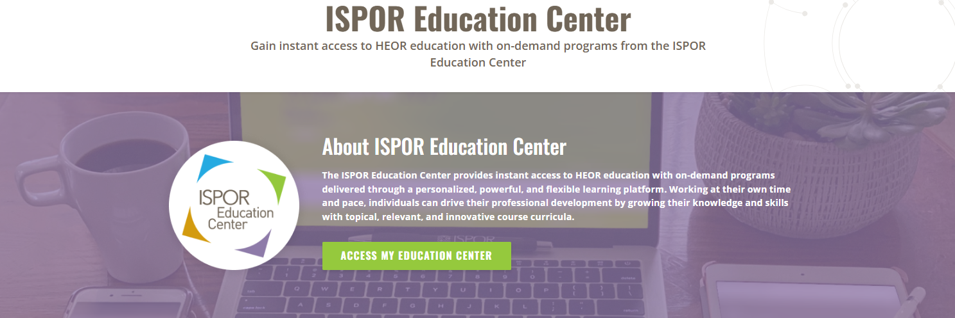

Slide 22





ISPOR Publications
Now Open Access
www.ispor.org/publications

Slide 23


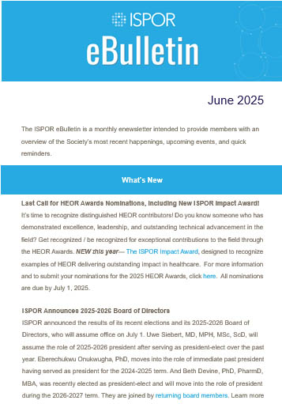
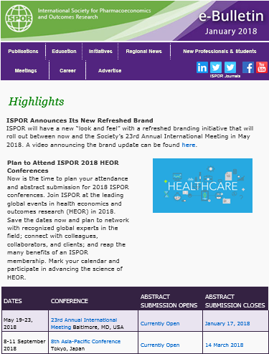
ISPOR Newsletters
Newsletters
eBulletin
Member News
Member Group
Newsletters
  News Across the Globe
  Student News

Slide 24


^{HEOR by Topic}
www.ispor.org/HEORbyTopic

Slide 25


Slide 26
Member Groups
SECTION
4

Slide 27









ISPOR Member Groups
Special Interest Groups
Task Forces
Councils & Roundtables
Initiatives & Committees
Consortia, Networks, Chapters
Students & New Professionals

Slide 28

Global Engagement
The Society’s consortia, networks, and chapters develop HEOR at the local and regional level through regional conferences, newsletters, research, educational programs, and Value in Health Regional Issues.
Asia Consortium
Central and Eastern Europe Consortium
Latin America Consortium
Africa Network
Arabic Network
Regional Chapters

Slide 29

ISPOR Councils
ISPOR’s global, regional, and local councils act as advisory bodies to the Society and provide direction on key issues in
health economics and outcomes research.
  Education Council
  Global Engagement Council
  Health Science Policy Council
  Health Technology Assessment Council
  Institutional Council
  Patient Council
  Faculty Advisor Council

Slide 30


ISPOR Roundtables
ISPOR’s roundtables provide an unbiased forum for
key decision-making stakeholders from around the world
to learn from each other and advance the science of HEOR.
Health Technology Assessment Roundtables
Patient Representatives Roundtables

Slide 31


New Professionals
ISPOR New Professionals’ member benefits are designed to serve the unique needs of future health economics and outcomes research leaders.
New
HEOR Professional

Slide 32
Special Initiatives
SECTION
5

Slide 33





Real-World Evidence Transparency Initiative
A partnership between ISPOR, the
International Society for Pharmacoepidemiology, the Duke-Margolis Center for Health Policy,
and the National Pharmaceutical Council.
www.ispor.org/rwetransparency

Slide 34


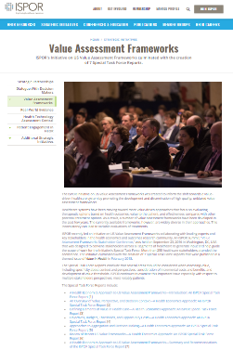
Initiative on US Value Assessment Frameworks
ispor.org/valueframeworks
The ISPOR Initiative on
US Value Assessment Frameworks
was created to inform the shift towards
a value-driven healthcare system
by promoting the development and dissemination of high-quality, unbiased value assessment frameworks.

Slide 35





Comparative Effectiveness Research Collaborative
Advances the use of comparative evidence to improve health outcomes
Provides today’s formulary decision makers with guidance on how to interpret, evaluate, and use new research through:
  Assessing the Evidence for Healthcare Decision Makers
  online questionnaire
  Synthesizing a Body of Evidence online guided review
  Online training and CER Certificate Program

Slide 36

ISPOR HEOR Competencies Framework™
Initiatives Objectives:
  To comprehensively define the health economics
  and outcomes research discipline, including:
    Competencies professionals need for
    success in the field
    Competency gaps that are often seen
    in candidates and employees
    Training/education gaps that
    need to be addressed

Slide 37
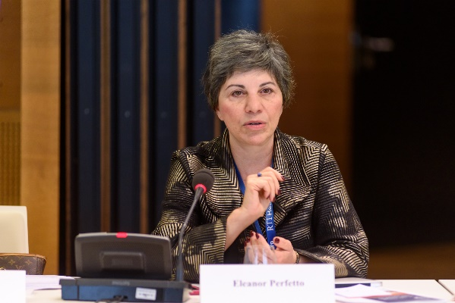
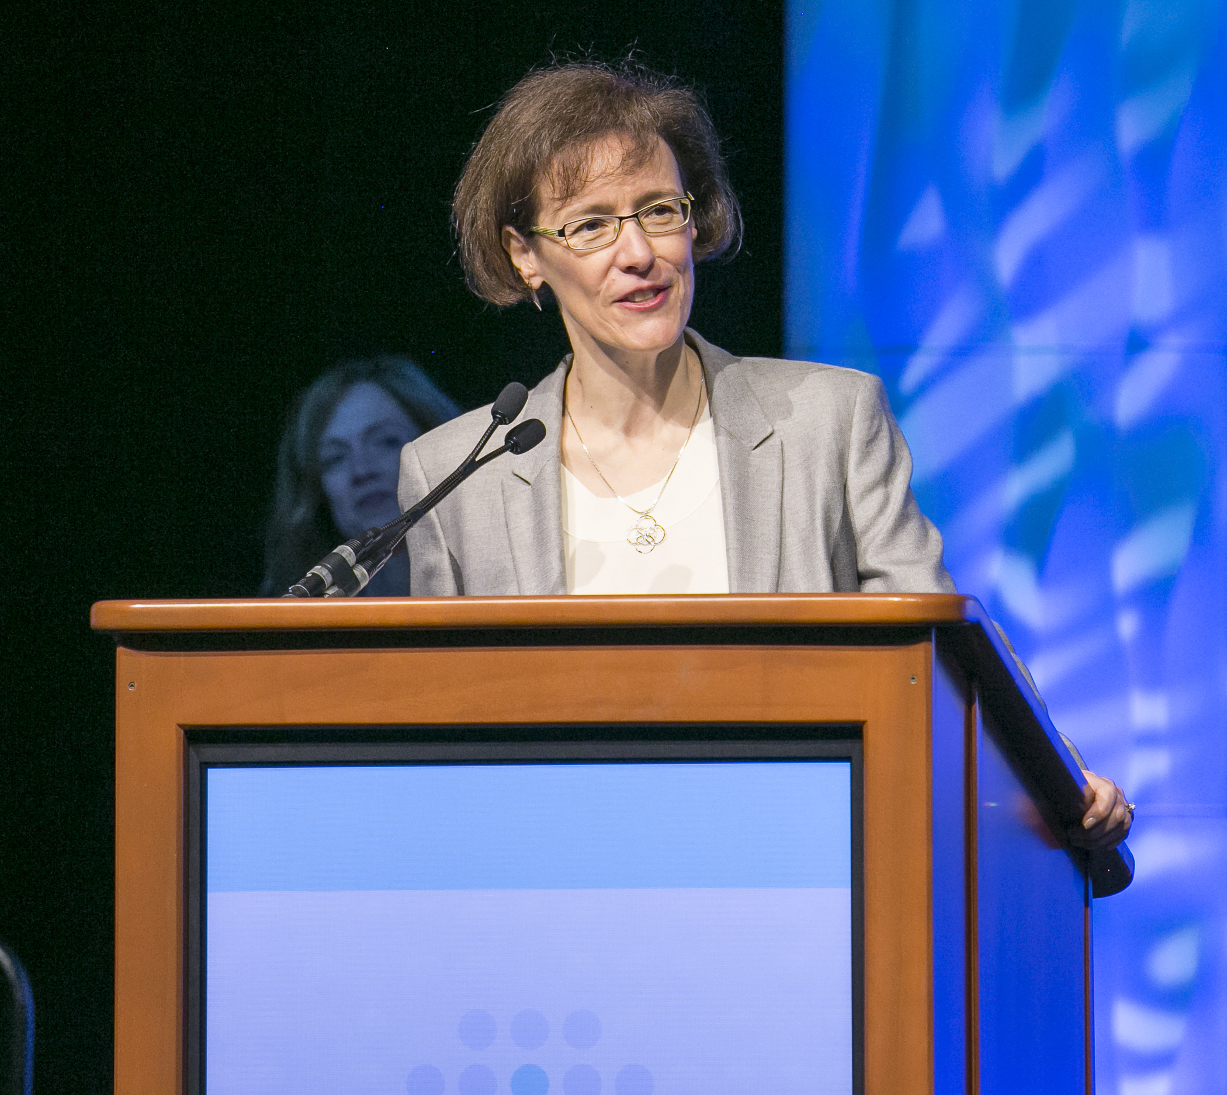

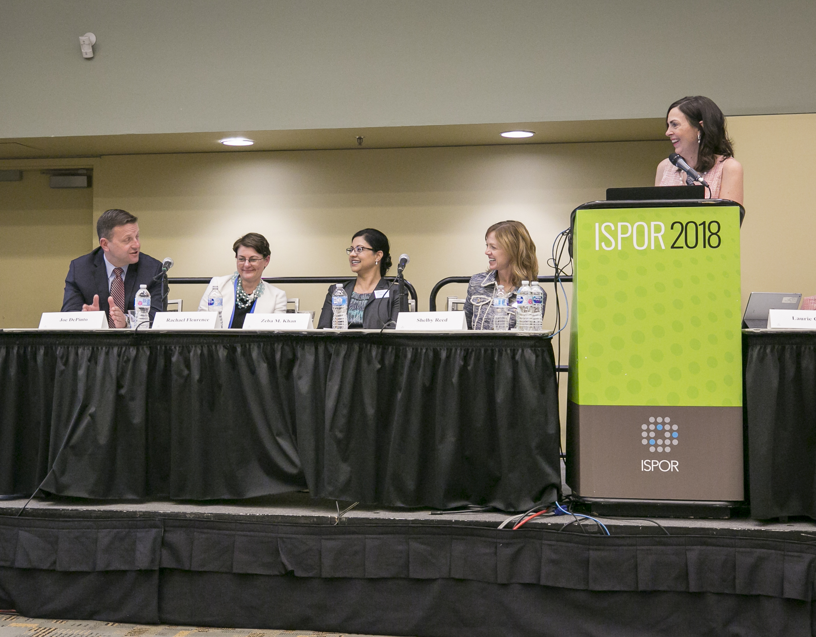

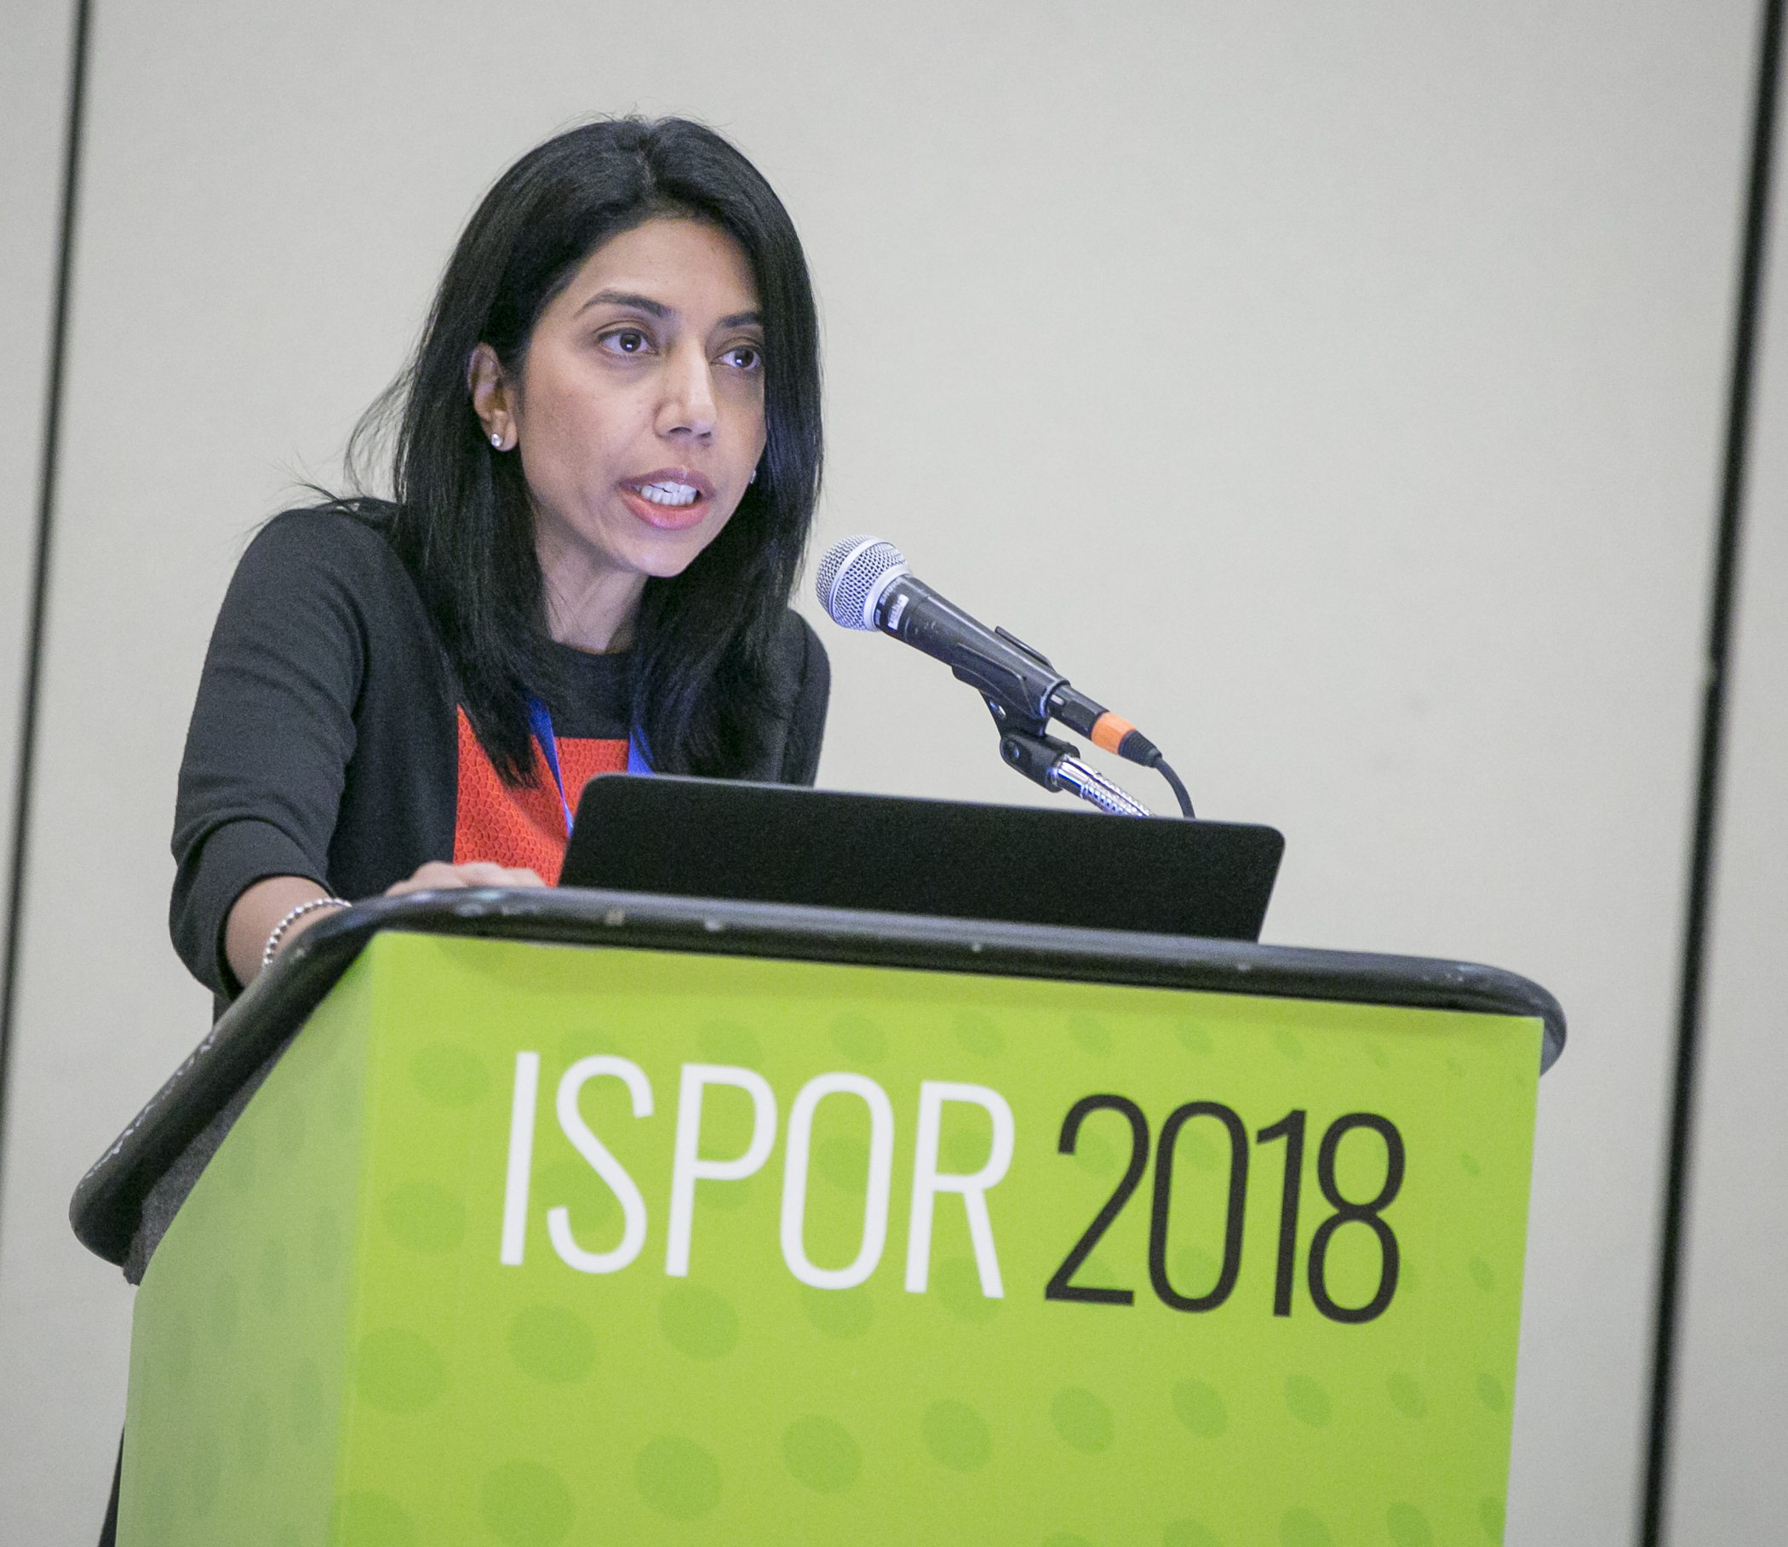

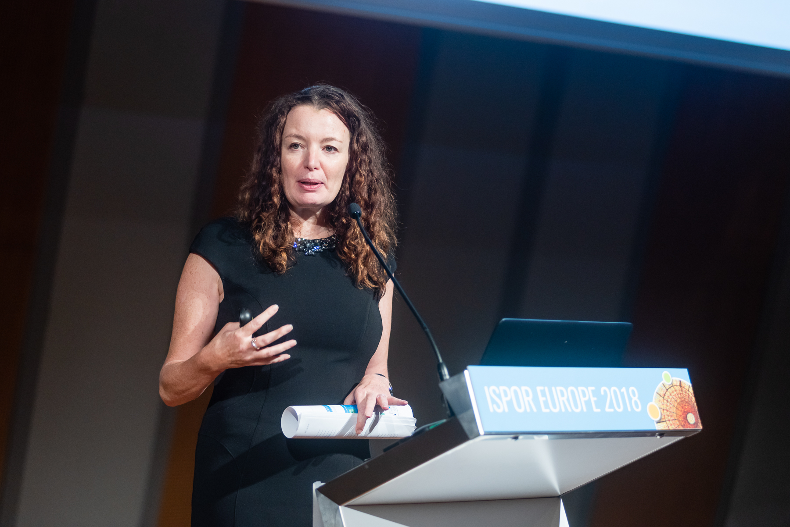
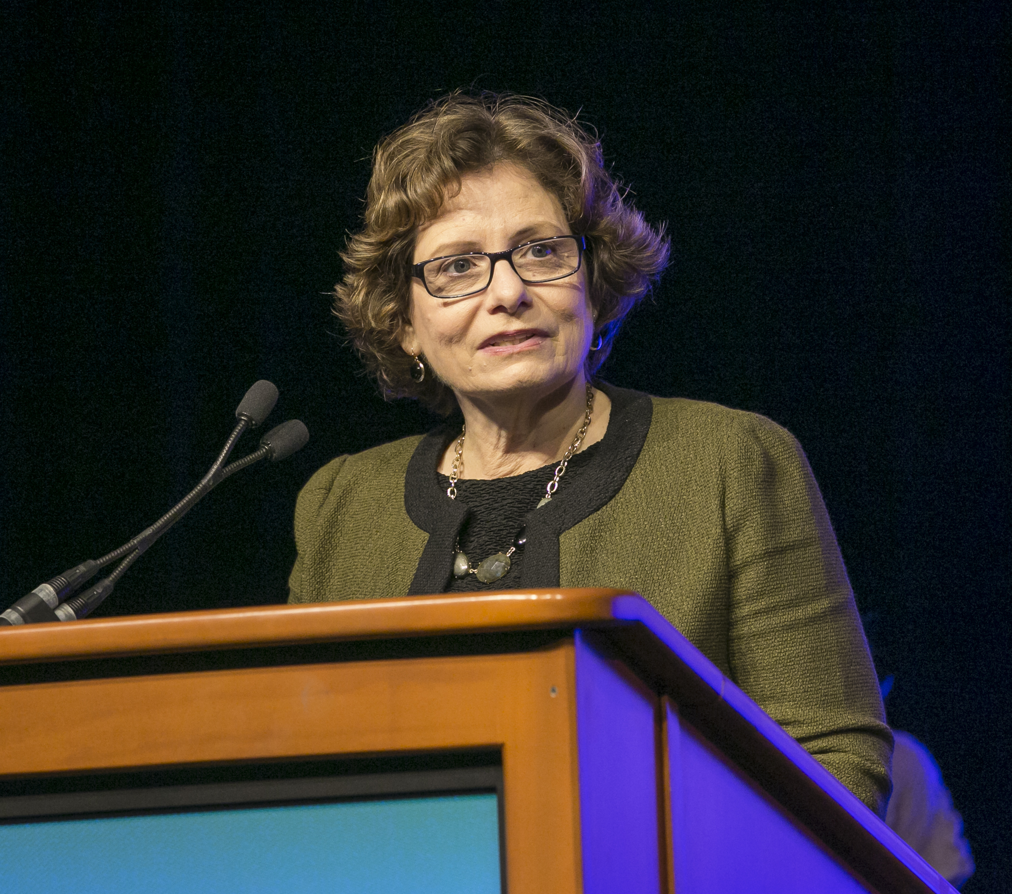
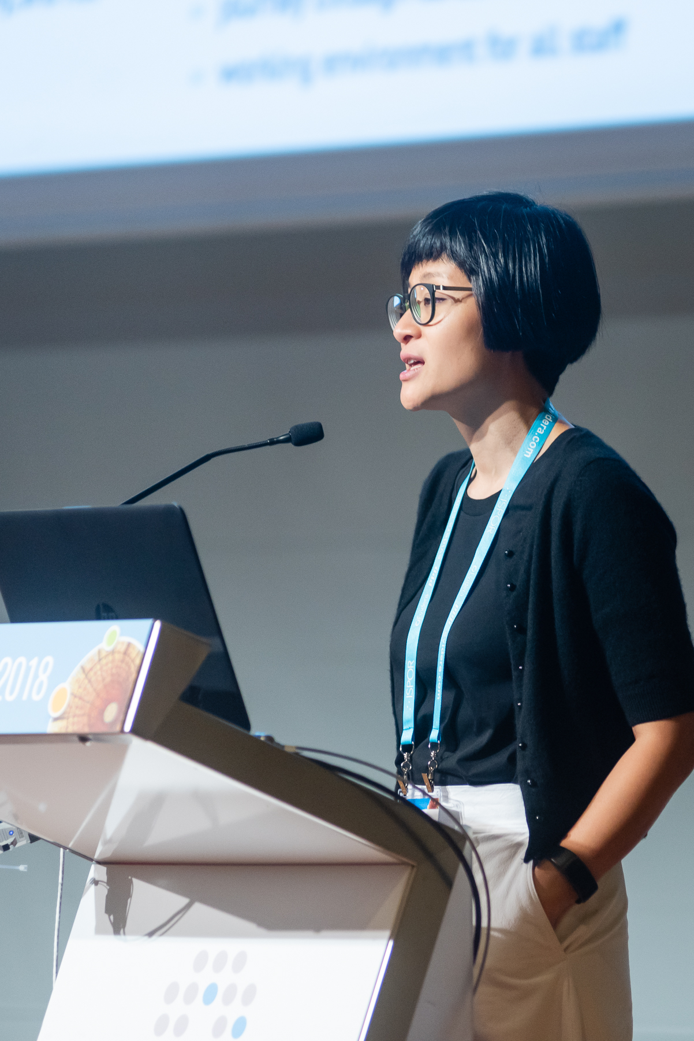
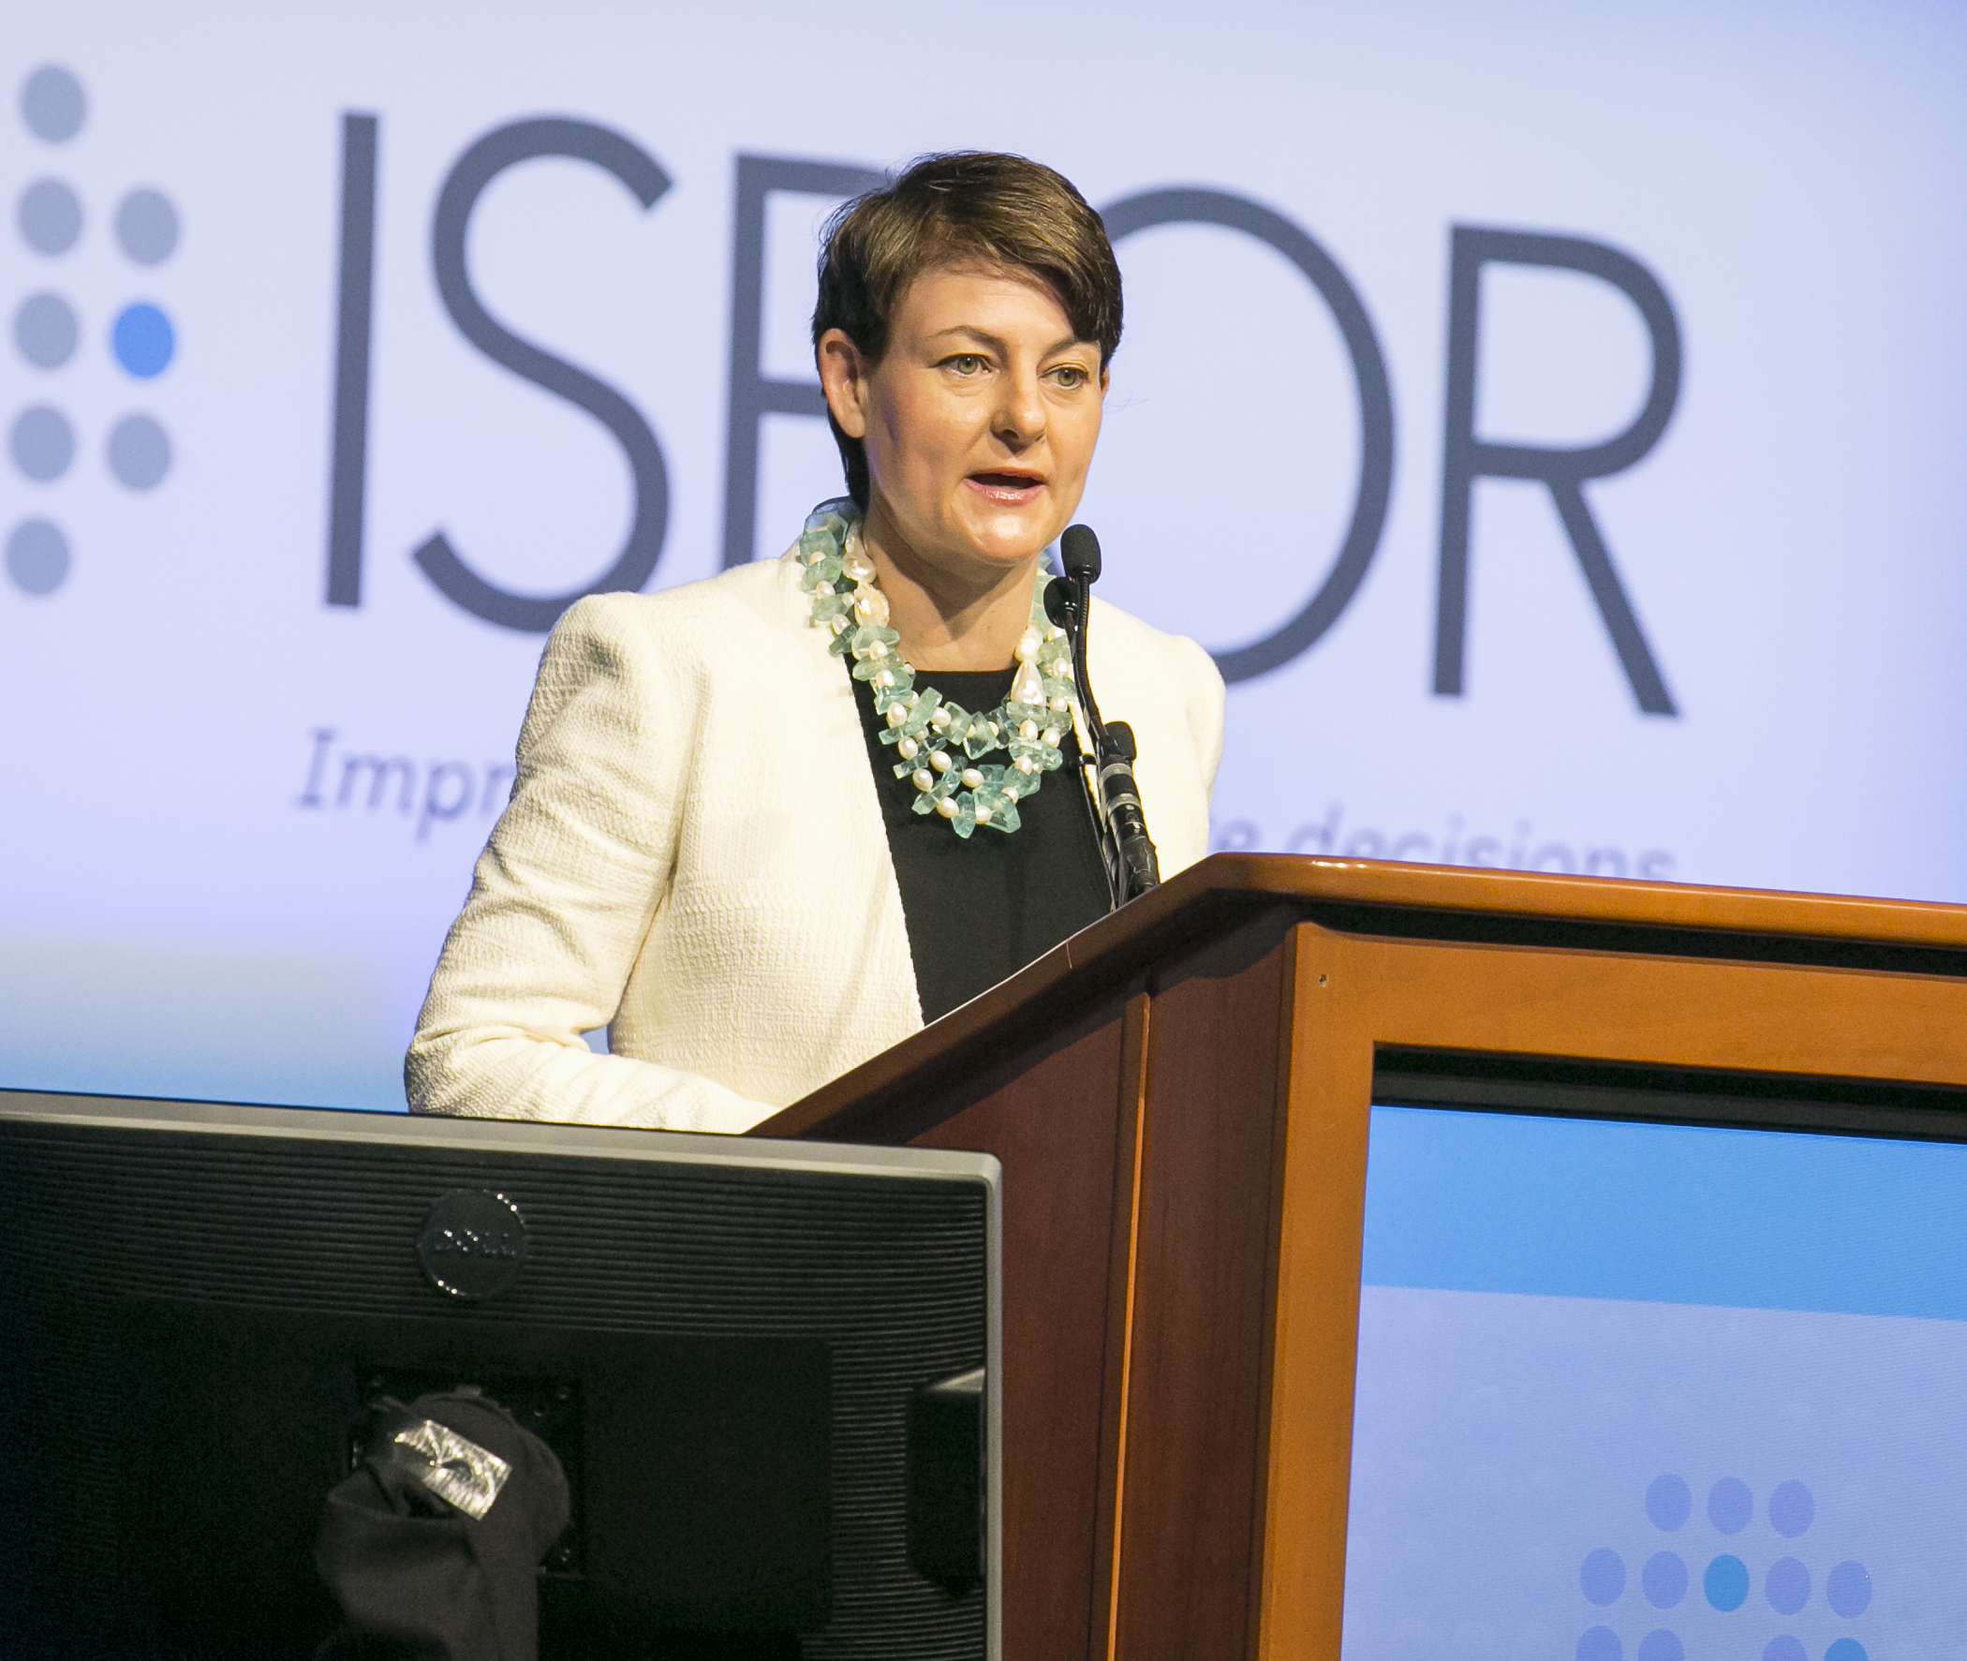
Women in HEOR Initiative
To support the growth, development, and contribution of women in health economics and outcomes research (HEOR)
To serve as a catalyst for women’s leadership in the field
To offer a platform for ISPOR women to collaborate, network, share, and mentor each other

Slide 38
ISPOR Branding
SECTION
6

Slide 39
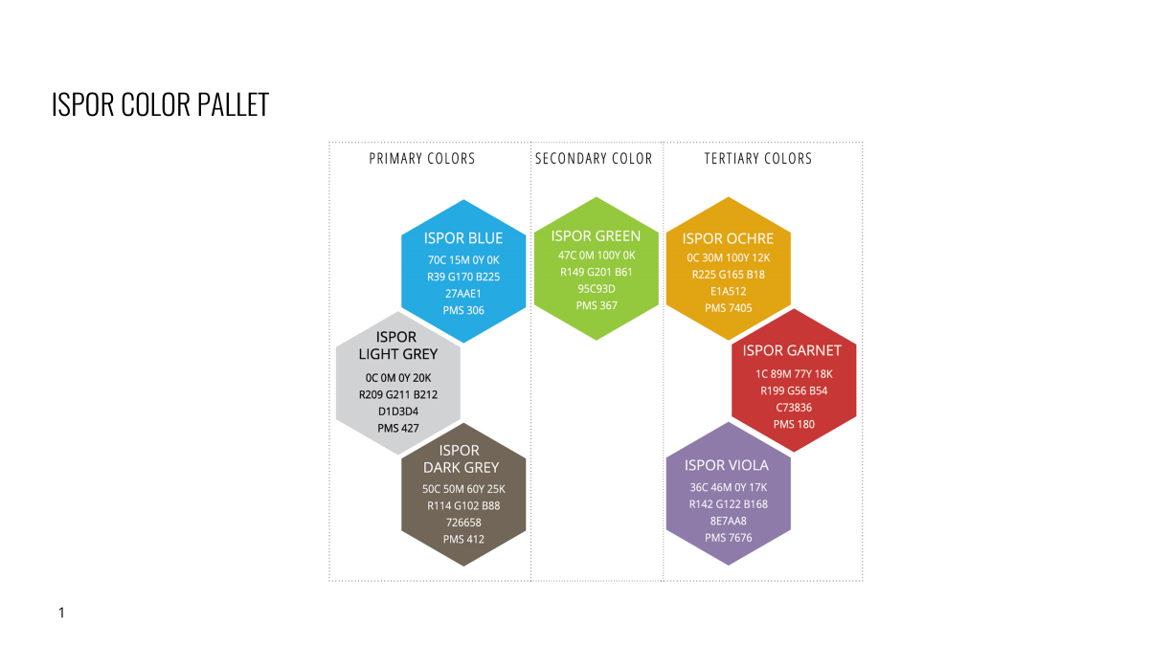

Slide 40
ISPOR PPT TYPE PALLET
Brand Font set
Open Sans
Open Sans Light
Open Sans Regular
Open Sans Semibold
Open Sans Bold
Default Font set
Arial
Arial Regular
Arial Bold
Arial Black
Oswald
Oswald Extra Light
Oswald Light
Oswald Regular
Arial Narrow
Arial Narrow Regular
Arial Narrow Bold

Slide 41





ISPOR SIGNATURE AND LOGO

Slide 42






Follow Us—@ISPORorg!
Join the #HEOR Conversation
LinkedIn
Facebook
Instagram
X/Twitter
Notes:
Updated 4/2024 (Robert and Jenn)

