Slide 1
ISPOR NEW PROFESSIONALS Career Advice Across the Globe
“Effectively Communicating & Presenting Your Research”
Monday, May 21, 2018 | 11:00-12:00 PM EDT
Room: 316-317

Slide 2
New Professional Overview
New Professional membership consists of recent graduates from Health Economics and Outcomes Research related programs who have 3 years or less of HEOR experience
The membership is available to former ISPOR student members and any new members that fit the criteria to join
Eligible for discounted rate of $100 for two additional years after they join before becoming ISPOR Standard members
Current ISPOR Standard members are not eligible to downgrade their membership to New Professional.

Slide 3
Objectives
Career Advice Across the Globe will provide an opportunity for New Professional Members, and soon to graduate students, to hear good practices and experiences straight from HEOR experts. The theme of this session will be “Effectively Communicating & Presenting Your Research.”
Upon completion of the presentations there will be time for Q&A and Networking.

Slide 4
PANEL SPEAKERS:
Laura T. Pizzi, MPH, RPh, PharmD
Professor and Director, Center for Health Outcomes, Policy & Economics, Rutgers University, Ernest Mario School of Pharmacy, Piscataway, NJ, USA
Michael Drummond, PhD
Professor, University of York, Centre for Health Economics, Heslington, York, United Kingdom
Surachat Ngorsuraches, PhD
Associate Professor, South Dakota State University, College of Pharmacy & Allied Health Professions, Brookings, SD, USA

Slide 5
Career Advice Across the Globe - “Effectively Communicating & Presenting Your Research” 10 Tips that Cross Boundaries
PRESENTER
1
Presenter:
Laura T. Pizzi, MPH, RPh, PharmD,
Professor and Director, Center for Health Outcomes, Policy & Economics, Rutgers University, Ernest Mario School of Pharmacy, Piscataway, NJ, USA

Slide 6
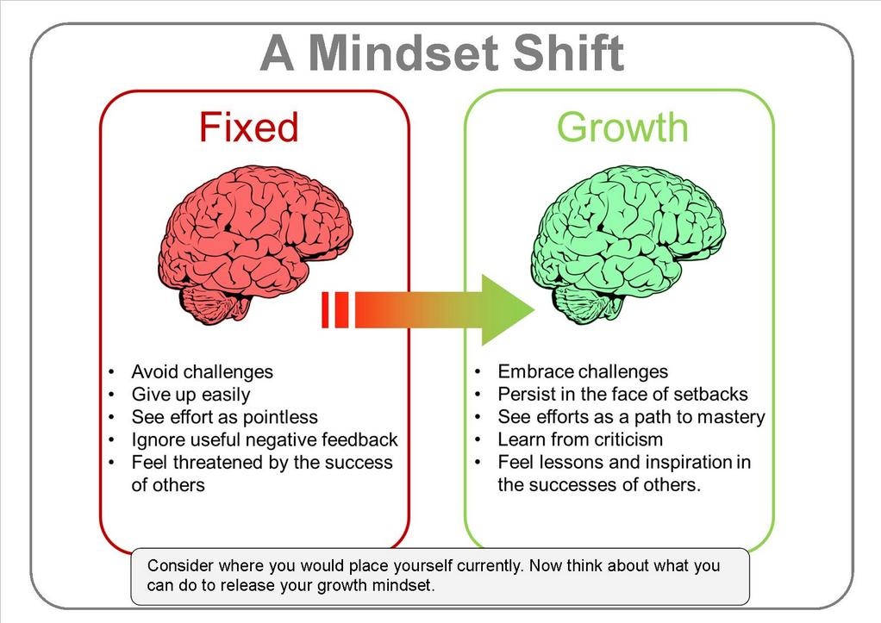
Approach scientific presentation with the right mindset.
Source: Indiana University Southeast Library. Available at: http://libguides.ius.edu/graduation

Slide 7
Every scientific presentation
you make is an investment in yourself.

Slide 8
Know your data.

Slide 9
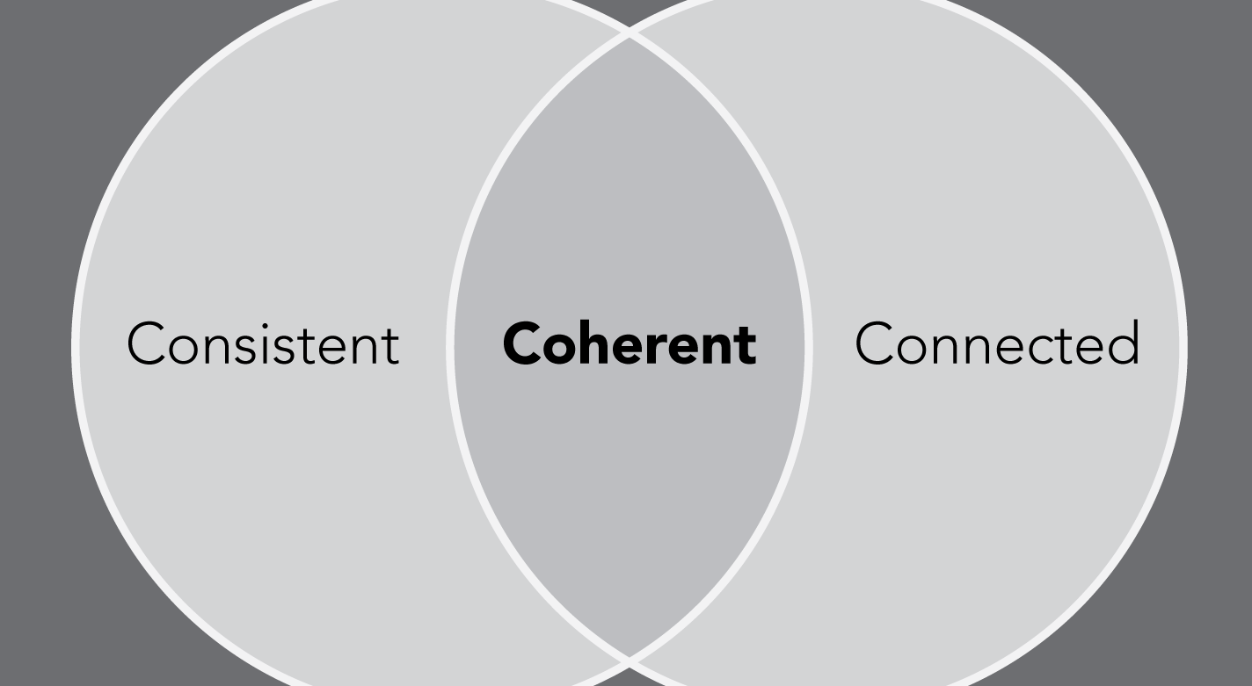
Content must be concise, consistent, and connected.

Slide 10
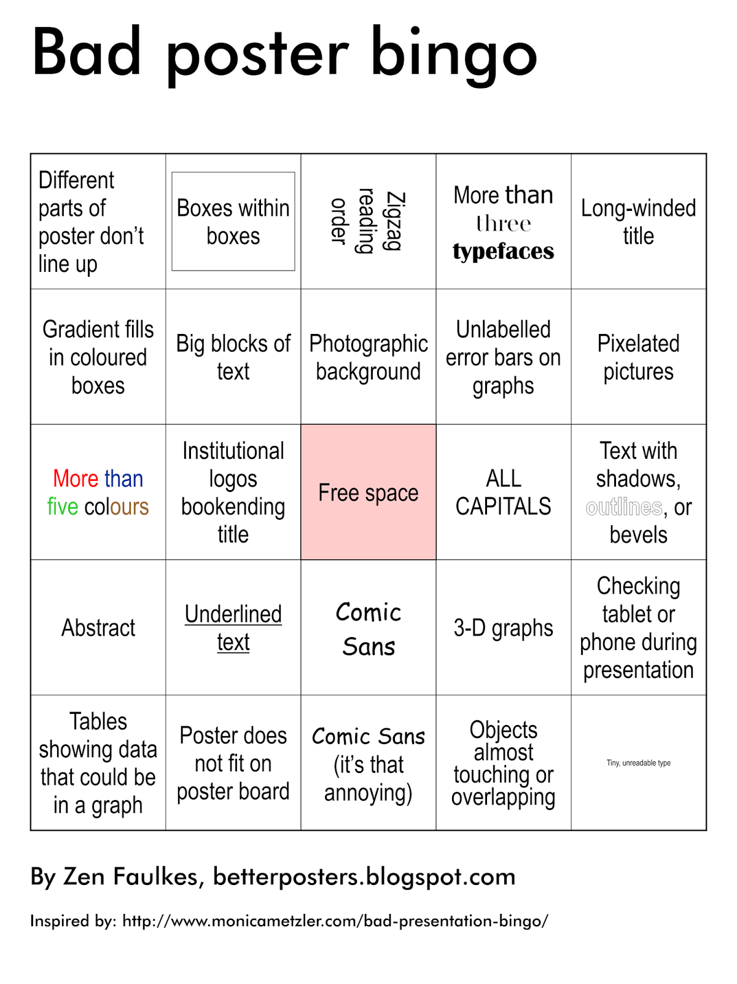
Effective visuals are vital.

Slide 11
Practice and proofread.

Slide 12
Visit your venue.

Slide 13
Treasure the time you’ve been given by being prompt.

Slide 14
Sell with your smile in seconds.

Slide 15
Respectfully seize connections.

Slide 16
Presenter: Michael Drummond, PhD Professor, University of York, Centre for Health Economics, Heslington, York, United Kingdom
PRESENTER
2
Career Advice Across the Globe - “Effectively Communicating & Presenting Your Research”

Slide 17
Outline of Presentation
Structuring your presentation
Considering your audience and the time constraints
Checking everything in advance
Developing your own presentation style
Summary

Slide 18
Structuring Your Presentation
Always start with an ‘Outline’ slide
The audience needs a ‘signposting’ of your talk; you might know where you are heading, but they don’t!
The structure is easiest for presentations of empirical research: Background/Objectives, Methods, Results, Discussion and Conclusions
In any case, it’s important to say:
why this research is needed
what your research adds to what we already know
what are the key implications (in decision-making or future research) of your conclusions.

Slide 19
Considering Your Audience and Your Time Constraints
In a conference presentation typically you only have 10-12 minutes; don’t spend 8 minutes on your ‘Background/Objectives slide!
Think about what your audience will be most interested in; that may not be what you are most interested in
Try to entertain as well as inform
Don’t assume that your audience knows all the abbreviations you use eg. NICE, ICER

Slide 20
Checking Everything in Advance
Make sure you go up onto the podium and check the equipment
Make sure that you know how to access your presentation
Figure out where you would put any papers, a glass of water and your watch/phone to keep the time
Don’t assume that everything will be the same as the last time you presented

Slide 21
Developing Your Own Presentation Style
Presenting is like conducting surgical operations; the more you do, the better you will get
Rehearse if you have to, but spontaneous presentations are the best
If you use jokes, choose them carefully
Encouraging audience interaction is good, but it depends on the type of talk/country you are presenting in

Slide 22
Choosing Your Jokes Carefully
Be respectful of the culture of the country you are presenting in
Some jokes are ‘safe’ and some jokes are ‘risky’
Here’s some examples!

Slide 24
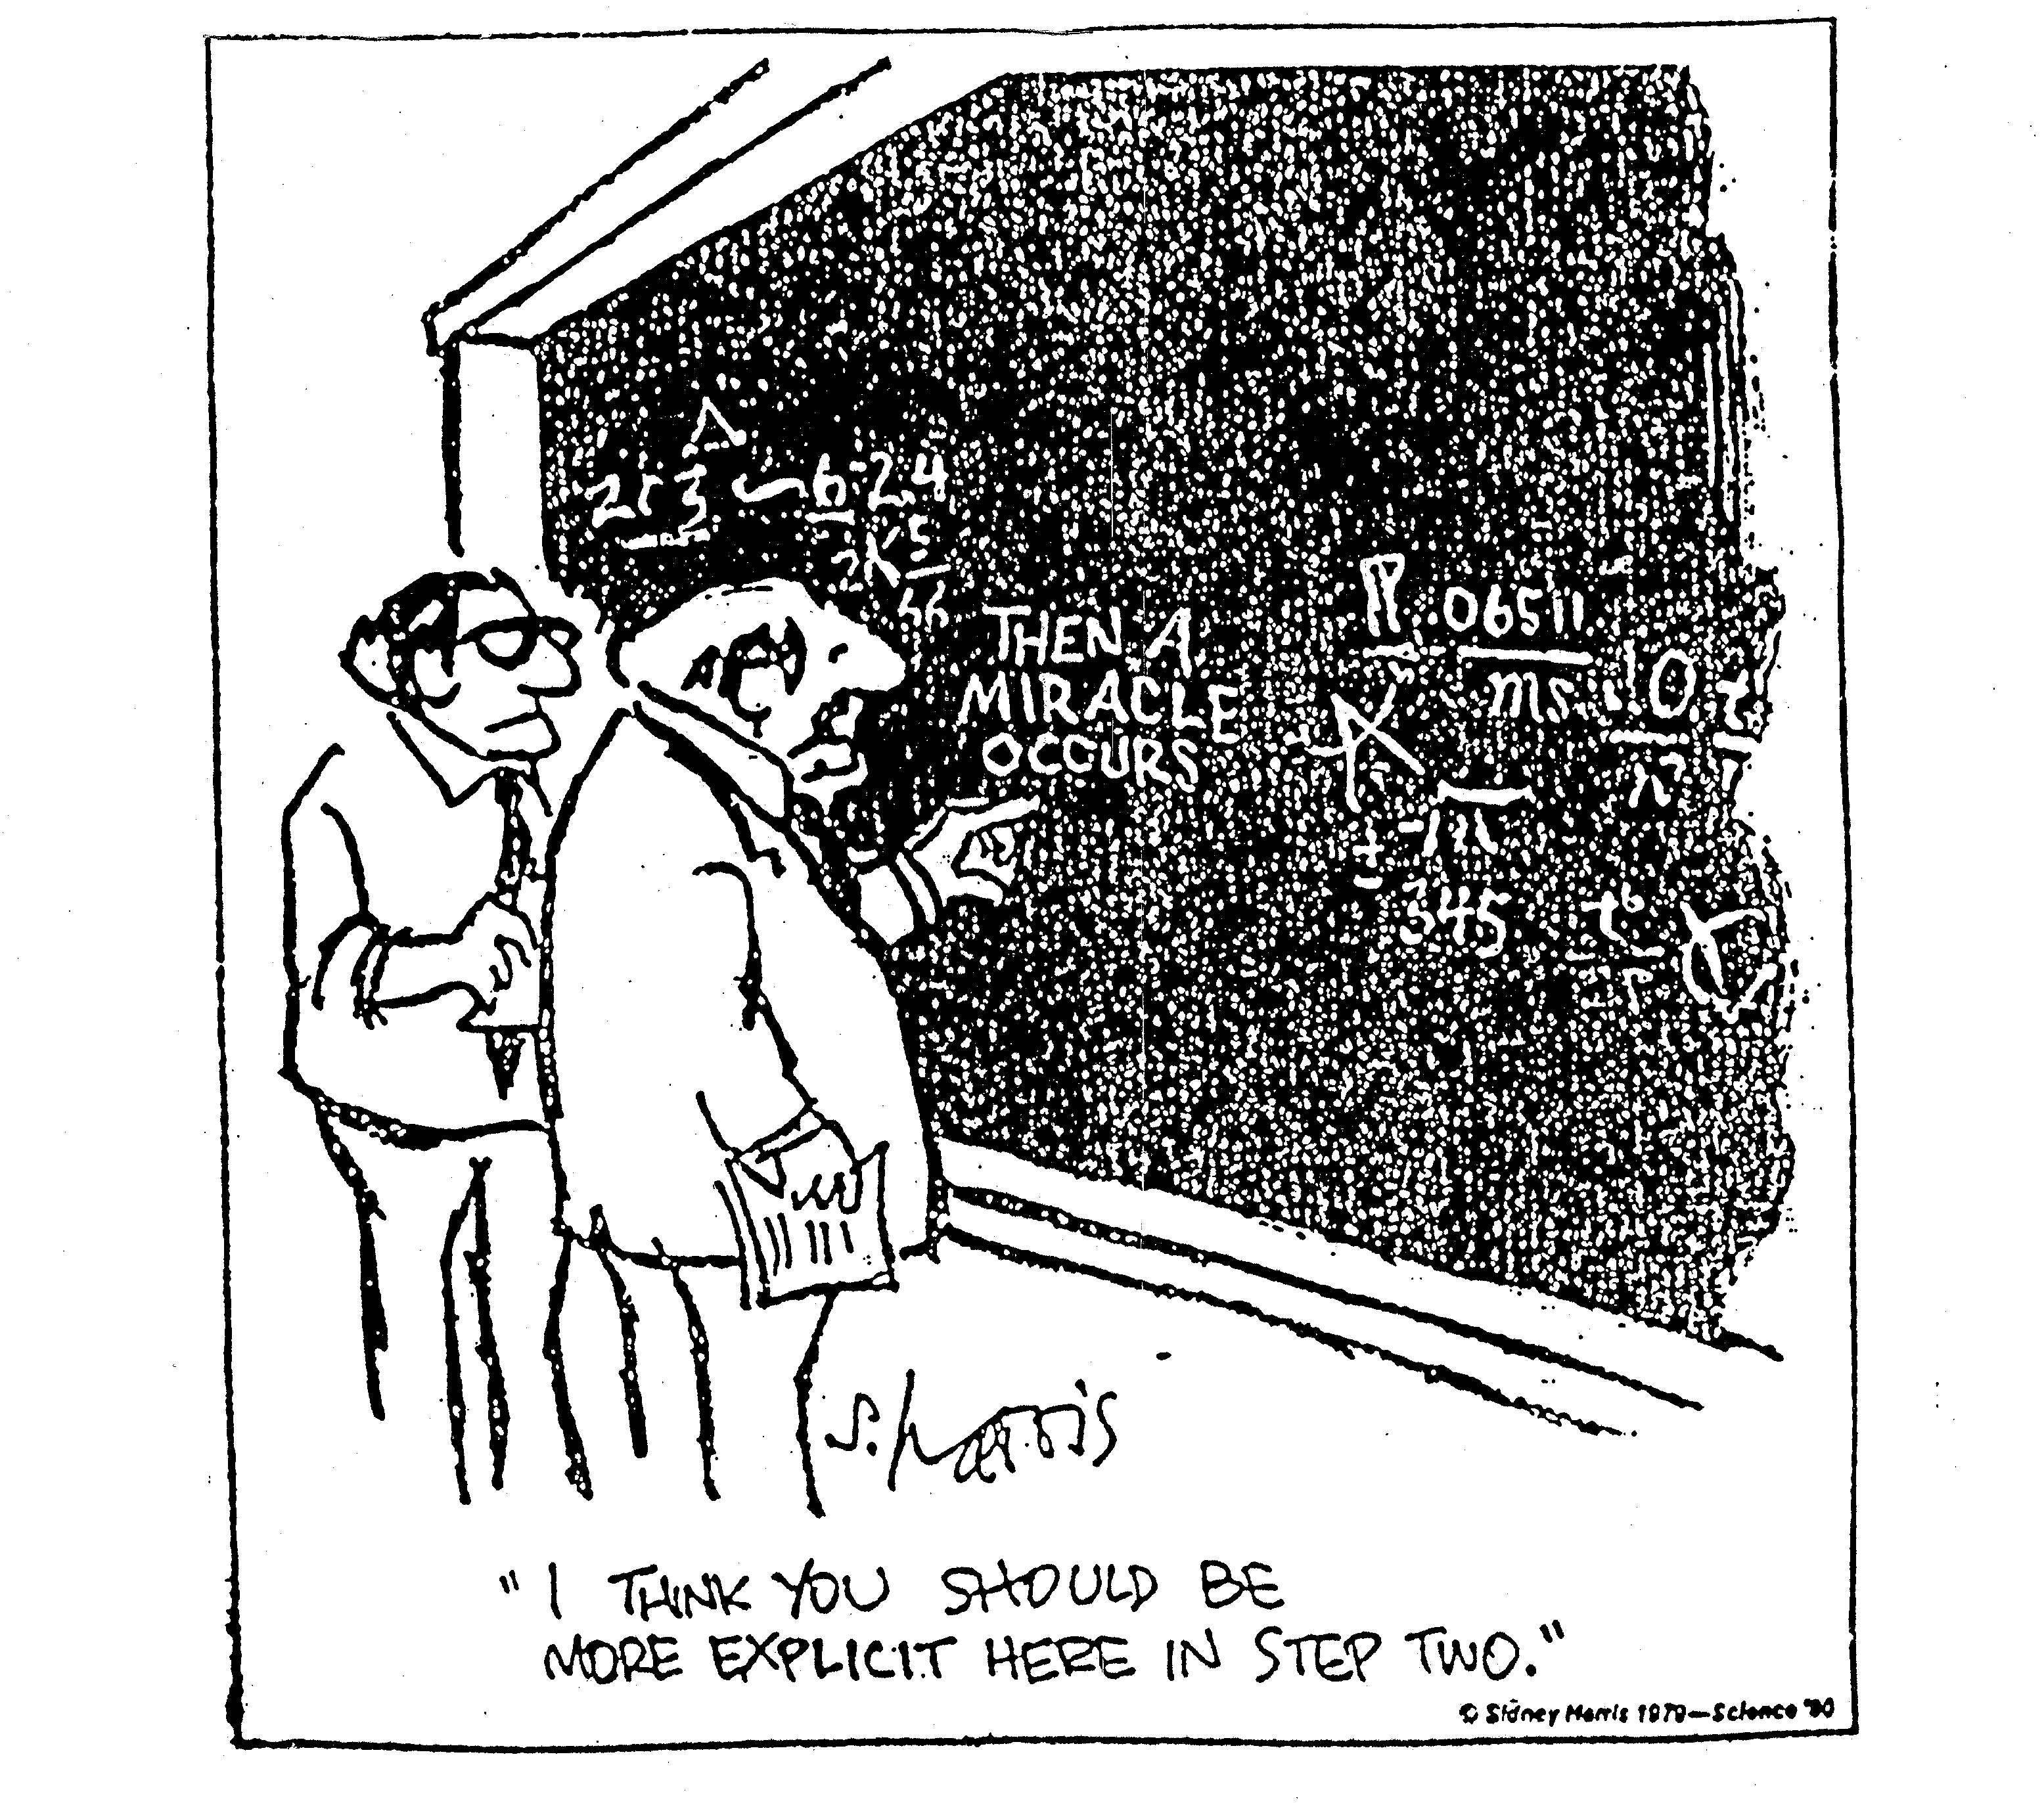

Slide 25
With a modelling study,
nobody knows you’re a dog

Slide 26
“Wow – look at the size of his model !”

Slide 27
Summary
Very few people are ‘natural’ presenters
It is quite normal to be nervous about speaking in public
The times that you are not nervous are the ones where you risk giving a bad talk
The more you present, the better you will get
Think of it as an opportunity as well as a challenge

Slide 28
Career Advice Across the Globe - “Effectively Communicating & Presenting Your Research”
PRESENTER
3
Presenter:
Surachat Ngorsuraches, PhD
Associate Professor
South Dakota State University
College of Pharmacy and Allied Health Professions Brookings, SD, USA

Slide 29
Patient Engagement in the Management of
Multiple Chronic Conditions (MCC)
NOTE: For Educational Purpose Only. This is not a serious presentation but for example only

Slide 30
Background
Outline
Project aims
Methods
Results & Discussions
Conclusions

Slide 31
Background
As of 2014, 41 percent of American adults had MCC.
RAND Health 2017

Slide 32
Prevalence of MCC by age
> 65 yo
45-64 yo
81%
50%
RAND Health 2017

Slide 33
Health care Utilization
RAND Health 2017

Slide 34
% of Total Expenditures
RAND Health 2017

Slide 35
Roles of Patient Engagement
A1C
Relationship
with Patient
Activation
Measure
(PAM)
DBP
NO
Relationship
with Patient
Activation Measure
(PAM)
HDL
Triglyceride
SBP
Hospitalization
LDL
ED visits
Greene et al. 2015

Slide 36
Project Aims
1. To develop a statistical model to measure
patient engagement level using predictors
from multiple behavioral measures.
2. To determine the association of patient
engagement with health-related outcomes
including clinical indicators and
healthcare costs

Slide 37
Conceptual Framework
race
gender
age
Predisposing factors
Clinical outcomes:- BP,
HDL, LDL, Triglyceride,
A1C, eGFR, ER visit
hospitalization
Healthcare costs:-
clinic charge, hospital
charge
PAM
Aim #2
marital status
health insurance
Enabling factors
1^{O} care provider
Patient Engagement Score (PES)
BMI
# diseases
Need factors
Aim #1
smoking
Behaviors
alcohol
Rx refills
no show
# immunization

Slide 38
Methods
De-identified data over 3 years (2014-2016) were obtained.
Study was reviewed by a privacy board and approved by IRB.
Only patients aged 18 years old or above with 2 or more chronic conditions were included.
A Gaussian finite mixture model was used to create a patient engagement score.
Multiple logistic and multiple linear regressions were used to examine association between patient engagement and health outcome.

Slide 39
Results & Discussions
Data extraction
1,143,028 records
<2 conditions; 981,392 records
161,636 records
Updated for age, added ICD-10, selected age 18 and above
161,060 records
Took the deceased off
147,687 records
146,245 records without PAM score
1,442 records with PAM score
5,095 records with generated PES

Slide 40
Descriptive statistics
 | All patients (146,687) | Patients with PAM (1,442)
Average age | 67 yo | 67 yo
Male | 52% | 37%
White | 94% | 94%
Married | 63% | 55%
Govt health insurance | 58% | 66%
Primary care provider | 79% | 94%
Smoking | 13% | 10%
Alcohol use | 45% | 39%
Average BMI | 31 | 32
Average # chronic conditions | 3 | 5

Slide 41
Aim#1: Patient engagement score
5,095 patients
Patient adherence to prescription refills
Patient attending to scheduled visits
Number of immunization over 3-years.
low (1), medium (2), and high (3) level of engagement.

Slide 42
Aim#2: Regression analyses
Association between PAM and health-related
outcomes or cost
PAM was not associated with any health-related outcomes.
Patients with lowest PAM likely had higher hospital charge,
compared to patients with highest level of PAM.
 | Ln(Hospital Charge)
 | Coefficient (SE) | P-value
PAM* 1 2 3 4 (reference) | 0.288 (0.145) 0.036 (0.101) 0.169 (0.109) | 0.046 0.719 0.123
*control variables: age, gender, race, marital status, health insurance,
PC provider, BMI, smoking, alcohol use, # chronic conditions

Slide 43
Association between PES and health-related
outcomes or cost
PES was associated with some health-related outcomes,
e.g. LDL, A1C, ED visits, eGFR, hospitalization, and
hospital charge
But, some results were counterintuitive.

Slide 44
Conclusions
Potential Patient Engagement Score (PES)
Patients with higher engagement level likely had lower
hospital costs.
Sanford Data Collaborative and SDSU

Slide 45
THANK YOU FOR ATTENDING

Slide 46
Q&A PERIOD

Slide 47
Exercises

Slide 48
Epidemiology & Demographics
2 million patients worldwide; 450,000 patients in US.¹
Olmstead County, MN: 191.2 per 100,000 (highest prevalence in US)²
Women: 3 times more than men.³
Majority of MS patients is Caucasian.³
African-American women have more active and rapidly progressive course of MS.⁴
(¹MS Coalition, 2017; ²Howard et al., 2016; ³ Evans et al. 2016; ⁴Langer-Gould et al., 2013)
Picture from www.pinterest.com

Slide 49
Impacts of MS
Annual cost of MS in the US: $2.5 billion.¹
Lifetime cost per patient: $4.1 million.²
A 3.3-fold increase in the odds of being unemployed.³
Lost on average 10.04 quality-adjusted life years.³
Family members:
Physical burden & psychological stress
missed 7 working days per year⁴
(¹NINDS, 2002; ²COwen et al., 2013; ³Campbell et al., 2014; ⁴Brandes et al, 2012)
Picture from www.pinterest.com

Slide 50
Nearly all of the patients with MS had health insurance coverage.¹
Costs per additional quality-adjusted life year (QALY)
for all DMTs, except alemtuzumab, ranged between
$183,300 to $355,300.²
High cost sharing could make patients pay high out-of-pockets
e.g. Medicare patients, with Part D enrollment, paid out-of-pocket
$5,979, $6,235, and $6,448 annually for Avonex®, Tecfidera®, and
Copaxone®, respectively.³
The coverage of DMTs usually restricts the decision.
e.g. require patients to attempt certain DMTs prior to covering newer
DMTs.⁴
(¹Pozniak et al., 2014; ²ICER, 2017; ³Wang et al., 2016; ⁴Lublin et al., 2013)

