Slide 1
Value of Information (VOI) Analysis for Research Decisions: Emerging Good Practices Task Force
Final Recommendations

Slide 2

Moderator:
Rachael Fleurence, PhD, National Evaluation System for Health Technology Coordinating Center (NESTcc), Medical Device Innovation Consortium (MDIC), Arlington, VA, USA
Panel:
Anirban Basu, PhD, The Comparative Health Outcomes, Policy, and Economics (CHOICE) Institute, University of Washington, Seattle, WA, USA
James Murray, PhD, Global Health Outcomes, Center of Expertise, Eli Lilly and Company, Carmel, IN, USA
Gillian D Sanders Schmidler, PhD, The Robert J. Margolis, MD, Center for Health Policy, Duke University, Washington, DC, USA
Lotte Steuten, PhD, MSc, Fred Hutchinson Cancer Research Center and The Comparative Health Outcomes, Policy, and Economics (CHOICE) Institute, University of Washington, Seattle, WA, USA
Notes:
Names are on each divider slide. Difficult to read so much text.

Slide 3
Task Force Members:
Claire Rothery, PhD, Co-Chair, Senior Research Fellow, University of York, York, England, UK
Elisabeth Fenwick, PhD, Co-Chair, Senior Principal, Health Economics, ICON plc, Abingdon, UK
Anirban Basu, PhD, Professor, Department of Pharmacy, University of Washington, Seattle, USA
Salah Ghabri, MD, PhD, Health Economist, Department of Economic and Public Health Evaluation, Haute Autorité de Santé, Paris, France
Saskia Knies, PhD, ‎Senior Advisor Pharmacoeconomics at National Health Care Institute (Zorginstituut Nederland), Diemen, the Netherlands
Notes:
We change the color slightly for speakers.

Slide 4
Task Force Members continued…
Erik Koffijberg, PhD, Associate Professor of Health Economics, University of Twente, Enschede, The Netherlands
James F. Murray, PhD, Research Fellow, Global Health Outcomes and Real World Evidence, Center of Expertise, Eli Lilly and Company, Indianapolis, USA
Gillian D. Sanders Schmidler, PhD, Associate Professor of Medicine and of Biostatistics and Bioinformatics, Duke Clinical Research Institute, Duke University, Durham, NC, USA
Lotte M.G. Steuten, PhD, Associate Member/Professor, Fred Hutch – HICOR / University of Washington – Department of Pharmacy, Seattle, USA
Mark Strong, PhD, Section Director, Public Health, University of Sheffield, Sheffield, England, UK
Notes:
This doesn’t make sense. Either change the header or delete objective

Slide 5
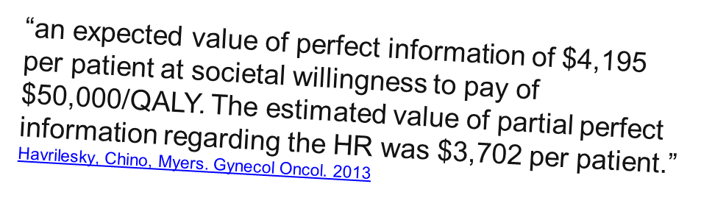
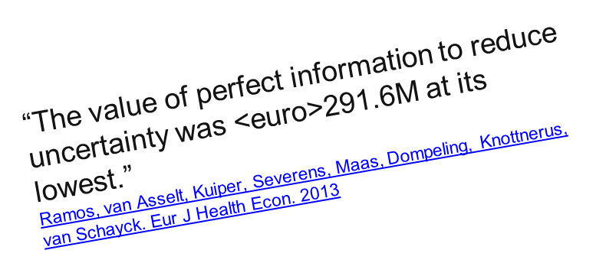
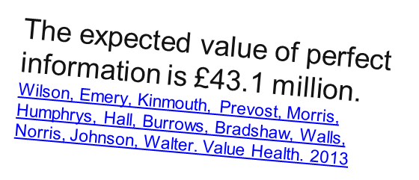
Recent examples of VOI
“EVPI per patient would be €204 at a €20,000 threshold value of society's willingness to pay for one quality-adjusted life-year. Given a future population of 30,400 individuals, total EVPI would be €6.19 million.”
Bartha, Davidson, Brodtkorn, Carlsson, Kalman. Trials. 2013
The expected value of perfect information (EVPI) associated with this decision is substantial (6.9 million pounds for the 20/40 model and 14.5 million pounds for the 20/80 model), with a sizeable EVPI associated with the effect of PDT on quality of life.
Bojke, Claxton, Sculpher, Palmer. Med Decis Making, 2008
Notes:
Pose the question
How would peers, reviewers and policy makers react if the above were done for clinical evidence?
But much better to standardise practice
Current practice undermines the rational for cost per QALY
the results generated using different methods are NOT directly comparable.

Slide 6
Task Force Objectives
Develop good practice guidance for VOI analysis methods to:
Characterize uncertainty and perform VOI
Aid in presentation and interpretation of VOI results
Reduce barriers to VOI implementation
Improve patient and health system performance outcomes
The task force will follow directly on from the ISPOR-SMDM Modelling Good Research Practices Task Force on Model Parameter Estimation and Uncertainty (Briggs et al., 2012) and the methods used to address recommendations in the ISPOR Good Practices for Performance-Based Risk-Sharing Arrangements Task Force Report (Garrison et al., 2013).
Notes:
Pose the question
How would peers, reviewers and policy makers react if the above were done for clinical evidence?
But much better to standardise practice
Current practice undermines the rational for cost per QALY
the results generated using different methods are NOT directly comparable.

Slide 7
Specific Aims
Explain the importance of quantifying uncertainty and the value of further research for research prioritization decisions
Develop recommendations to assess when additional evidence is required to reduce uncertainty in decision making
Identify key steps and recommendations for good practices of performing, reporting, presenting and interpreting results of VOI analysis
Provide clarity on how results of VOI analysis can be embedded into decision making processes
Develop recommendations for use of VOI in jurisdictions that do not use cost-effectiveness information
Identify areas where continued methodological development in VOI techniques is warranted
Notes:
Pose the question
How would peers, reviewers and policy makers react if the above were done for clinical evidence?
But much better to standardise practice
Current practice undermines the rational for cost per QALY
the results generated using different methods are NOT directly comparable.

Slide 8
Report 1 – An Introduction
Audience:
decision makers / health care payers
stakeholder groups making research prioritization decisions
Content:
Role of VOI analysis
Definition of VOI concepts and terminology
Overview of steps to conduct a VOI analysis
Types of healthcare decisions supported by VOI analysis
Implications for research and policy decisions with discussion of/references to examples

Slide 9
Report 2 - Analytical Methods
Audience:
methodologists or analysts undertaking VOI analysis to inform decision making
Content:
Characterizing sources of uncertainty for VOI
Key concepts, definitions and notation of VOI
Methods for computing EVP(P) and EVSI
Reporting of VOI results
Other considerations
  minimal modelling describe how to monetize the value of further research
  relevance of VOI in different contexts
Resources, skills and software

Slide 10
Forum Presentation
Overview of VOI
A selection of the Good Practice Recommendations
Discussion:
VOI in practice
Barriers and potential solutions
Implications
Perspectives:
Funders of research
Industry
Academic/Analyst
Notes:
Pose the question
How would peers, reviewers and policy makers react if the above were done for clinical evidence?
But much better to standardise practice
Current practice undermines the rational for cost per QALY
the results generated using different methods are NOT directly comparable.

Slide 11
What is VOI?
SECTION
1
Lotte Steuten, PhD, MSc
Fred Hutchinson Cancer Research Center and The Comparative Health Outcomes, Policy, and Economics (CHOICE) Institute, University of Washington

Slide 12
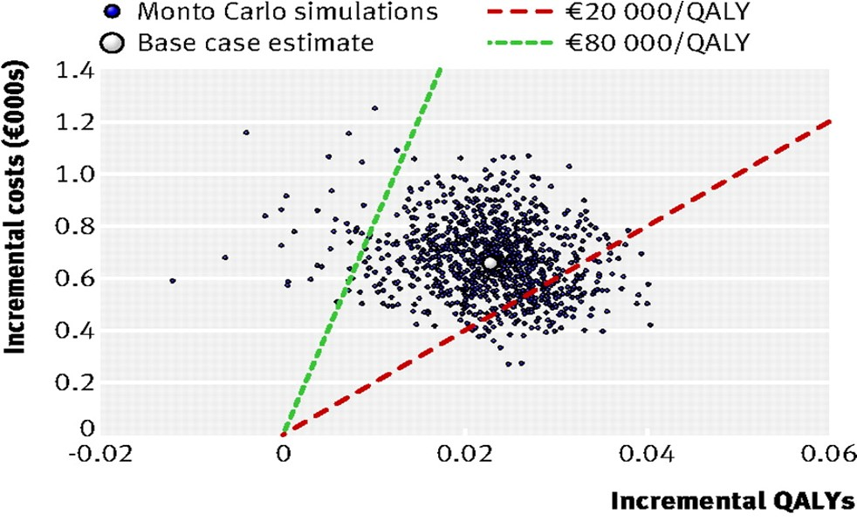
What is VOI?
By a show of hands:
Is it worth to conduct another trial?
A: Yes
B: No
C: That depends
D: Only if I am the 1st author

Slide 13
VOI: An intuitive example
One bag contains $100, while the other $0.
You must choose one (and only one!) bag
How much would you pay to look inside one bag before making your decision?

Slide 14
Decision tree

Slide 15

Without looking inside you have a 50:50 chance of winning $100.
  Expected value = $50 (50% of $100)
After looking inside (i.e. with PERFECT information) there is a 100% chance of winning $100.
  Expected value = $100
Expected value of perfect information (EVPI)=$100-$50 =$50
?
?
?
?
?

Slide 16
What happens to VOI when there is more uncertainty?
Expected value without peeking is now only $20.
  20% of $100
Value of PERFECT information is still $100.
Expected value of perfect information (EVPI*) =
  $100 - $20 = $80
Value of information is higher when there is more uncertainty.
*peeking in 4 bags
?
?
?
?
?

Slide 17
One bag now contains $1000!
Expected value with CURRENT info is now $500.
  50% of $1000
Value of PERFECT information is $1000.
Expected value of perfect information =
  $1000- $500 = $500
Value of information is higher when consequences of a (wrong) decision are larger.
?
?
?
?
?

Slide 18
VOI metrics
EVPI = expected cost of uncertainty
EVPPI = expected cost of uncertainty about (groups of)
individual parameters
EVSI = expected reduction in uncertainty by a trial of a
given sample size n
ENBS = EVSI – minus costs of a study with sample size n
Notes:
Pose the question
How would peers, reviewers and policy makers react if the above were done for clinical evidence?
But much better to standardise practice
Current practice undermines the rational for cost per QALY
the results generated using different methods are NOT directly comparable.

Slide 19
Selected Good Practice Recommendations
SECTION
2.1
VOI Report 1 – An Introduction

Slide 20
Task Force Objectives
Introduce VOI analysis
Explain why it should be important to decision-makers
Identify the types of healthcare decisions that can be supported by VOI analysis, as well as its limitations
Describe how the methods should be used and how the results should be interpreted
Explain how VOI analysis can support decision-making in different contexts.
The report does not provide detail on the costing or grading of evidence from specific studies.
Notes:
Pose the question
How would peers, reviewers and policy makers react if the above were done for clinical evidence?
But much better to standardise practice
Current practice undermines the rational for cost per QALY
the results generated using different methods are NOT directly comparable.

Slide 21
Selected Good Practice Recommendations – Report 1
For a proper quantitative assessment of uncertainty, which accounts for uncertainty in all parameters simultaneously, a probabilistic analysis of the decision model is required.
The decision model should be determined by the decision problem; NOT simply by data availability.
  All current evidence should be considered with the uncertainty appropriately characterized.
  Parameters should not be excluded due to a lack of data as anything not captured in the model structure or parameters will not be captured in VOI.
Notes:
Pose the question
How would peers, reviewers and policy makers react if the above were done for clinical evidence?
But much better to standardise practice
Current practice undermines the rational for cost per QALY
the results generated using different methods are NOT directly comparable.

Slide 22
Selected Good Practice Recommendations – Report 1
The size of the beneficiary population should be calculated based on the prevalent and/or incident cohorts as appropriate given the decision problem.
  The beneficiary population should be reduced by the number of patients to be enrolled in a future study if the decision is delayed to gather more information, as they will generally not benefit from the information yielded.
Justification for the effective time horizon should be stated explicitly, and the impact of alternative durations on the VOI results should be explored in a scenario analysis.
Notes:
Pose the question
How would peers, reviewers and policy makers react if the above were done for clinical evidence?
But much better to standardise practice
Current practice undermines the rational for cost per QALY
the results generated using different methods are NOT directly comparable.

Slide 23
Selected Good Practice Recommendations – Report 1
Population EVP(P)I should be calculated and compared against the costs of research to determine if further research is potentially worthwhile.
EVPPI should be undertaken for groups of parameters where it is likely that further research would be informative for the whole group, rather than for individual parameters.
EVSI estimates for each proposed study design should be compared to the expected costs of the study to determine if the specific study is valuable.
  Where the number of proposed study designs is large, optimization methods can be used to identify the study with the greatest Expected Net Benefit of Sampling (ENBS) (Conti and Claxton, 2009).
Notes:
Pose the question
How would peers, reviewers and policy makers react if the above were done for clinical evidence?
But much better to standardise practice
Current practice undermines the rational for cost per QALY
the results generated using different methods are NOT directly comparable.

Slide 24
Selected Good Practice Recommendations – Report 1
Other factors with potential relevance to decisions that should be considered in VOI analysis include:
  likelihood that research will be undertaken if an intervention is generally funded compared with being funded only in the context of research
  the extent of irreversible costs being incurred in delivering a new intervention
  whether other information of relevance is likely to emerge over time.
Notes:
Pose the question
How would peers, reviewers and policy makers react if the above were done for clinical evidence?
But much better to standardise practice
Current practice undermines the rational for cost per QALY
the results generated using different methods are NOT directly comparable.

Slide 25
Selected Good Practice Recommendations
SECTION
2.2
VOI Report 2 – Analytical Methods
Anirban Basu PhD,
Professor, Department of Pharmacy,
University of Washington

Slide 26
Task Force Objectives
Detailed guidance and emerging good practices on the principal methods required for assessing the value of research to inform a range of decisions
Primary audience for this report are methodologists or analysts who are responsible for undertaking and implementing VOI to support research decisions
Notes:
Pose the question
How would peers, reviewers and policy makers react if the above were done for clinical evidence?
But much better to standardise practice
Current practice undermines the rational for cost per QALY
the results generated using different methods are NOT directly comparable.

Slide 27
Decision-making contexts where VOI helpful
guiding commissioning and research prioritization decisions among competing research priorities;
informing conditional coverage decisions within health technology assessment, where decisions about the reimbursement of technologies can be delayed until research that is needed is mandated;
supporting early development decisions of new pharmaceutical or other medical products; and
identifying research needs and priorities in areas where there is limited evidence and important uncertainties
Notes:
Pose the question
How would peers, reviewers and policy makers react if the above were done for clinical evidence?
But much better to standardise practice
Current practice undermines the rational for cost per QALY
the results generated using different methods are NOT directly comparable.

Slide 28
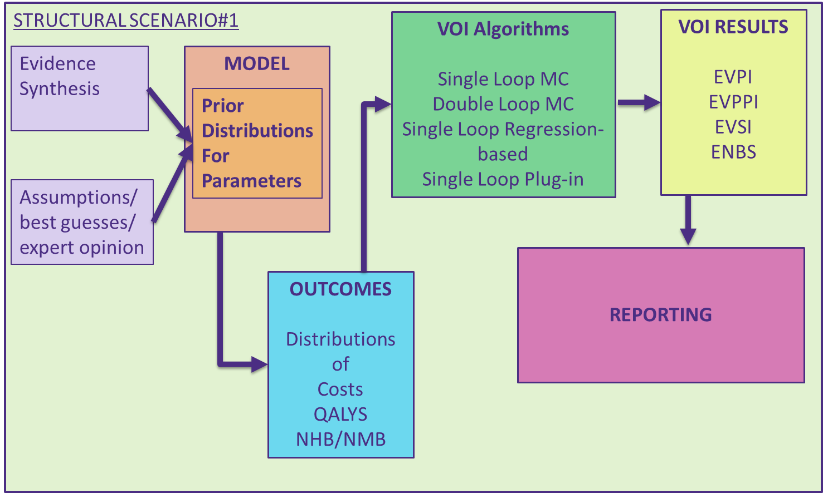
VOI Calculations & Reporting
Notes:
Pose the question
How would peers, reviewers and policy makers react if the above were done for clinical evidence?
But much better to standardise practice
Current practice undermines the rational for cost per QALY
the results generated using different methods are NOT directly comparable.

Slide 29
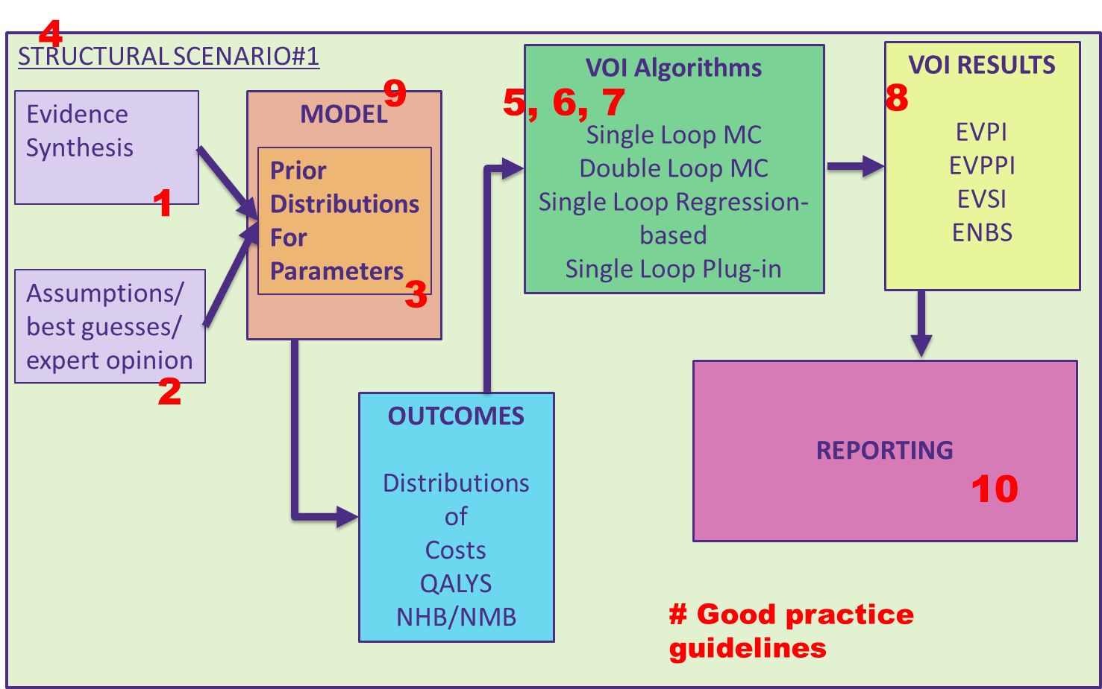
VOI Calculations & Reporting
Notes:
Pose the question
How would peers, reviewers and policy makers react if the above were done for clinical evidence?
But much better to standardise practice
Current practice undermines the rational for cost per QALY
the results generated using different methods are NOT directly comparable.

Slide 30
Panel Discussion
SECTION
Moderator:
Rachael Fleurence, PhD, National Evaluation System for Health Technology Coordinating Center (NESTcc), Medical Device Innovation Consortium (MDIC),
Anirban Basu, PhD, The Comparative Health Outcomes, Policy, and Economics (CHOICE) Institute, University of Washington,
James Murray, PhD, Global Health Outcomes, Center of Expertise, Eli Lilly and Company
Gillian D Sanders Schmidler, PhD, The Robert J. Margolis, MD, Center for Health Policy, Duke University, Washington, DC, USA
Lotte Steuten, PhD, MSc, Fred Hutchinson Cancer Research Center and The Comparative Health Outcomes, Policy, and Economics (CHOICE) Institute, University of Washington
3

Slide 31
Topics for Panel Discussion
How could/should VOI methods be utilized within current decision-making frameworks?
How could/should decision-making frameworks be altered to allow greater use of VOI?
What needs to be done to improve understanding of VOI methods?
How could/should industry use VOI in stop/go decisions
How best to compare the value of research to the cost of research?
Notes:
Pose the question
How would peers, reviewers and policy makers react if the above were done for clinical evidence?
But much better to standardise practice
Current practice undermines the rational for cost per QALY
the results generated using different methods are NOT directly comparable.

Slide 32
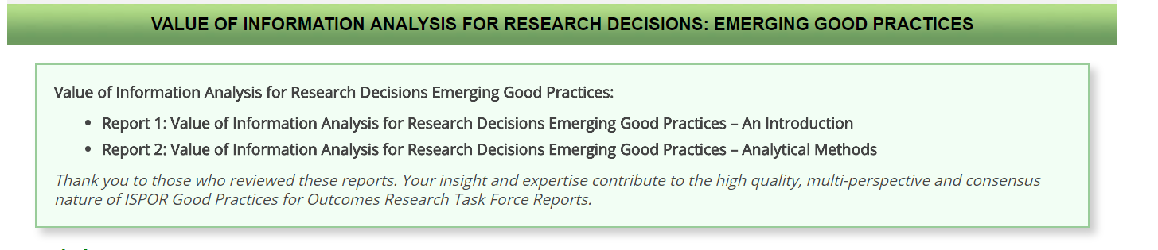
The task force reports will be submitted to Value in Health in Summer 2018. Expected publication is Fall 2018.

Slide 33
VOI Task Force Activities at Upcoming ISPOR Conferences
Short Course at ISPOR Europe 2018: Barcelona
Abstract submission likely for ISPOR Europe 2018: Barcelona
ISPOR Europe 2018 | Centre de Convencions Internacional de Barcelona, Barcelona, Spain (10-14 November 2018)
Abstract Submission Deadline: 13 June 2018
Workshop at ISPOR Asia Pacific 2018: Tokyo
ISPOR Asia Pacific 2018 | Keio Plaza Hotel Tokyo, Tokyo, Japan
(10-14 November 2018)

Slide 34

JOIN the VOI review group!
Being a member will keep you abreast of future ISPOR VOI activities!

Slide 35

Slides are available on the ISPOR 2018 Baltimore webpage https://www.ispor.org/Event/index/2018Baltimore

