Slide 1
Gene Sans
Gene Condensed (awaiting)
Gene Serif
ISPOR Boston 2023
Leveraging Insights from Distributional Cost-Effectiveness Analysis in HTA
Stacey Kowal
Chair, Health Equity Research Special Interest Group
Principal Researcher, Health Policy and Systems Research
Genentech, Inc
Kowal.Stacey@gene.com

Slide 2
Disclosures
DCEA of Inpatient COVID-19 treatments: Study funding from Genentech, Inc.
S Kowal is an employee of Genentech, Inc., South San Francisco, CA

Slide 3
Quantifying Equity and Efficiency Tradeoffs with D.C.E.A
Estimation of value can be a dual objective, balancing total net impact on population health as well as net impact on health equity
Notes:
Concept: The choices we make in healthcare can widen (or improve on) the (systematic) inequalities we have in healthcare given a variety of underlying reasons.
Impact on inequality should be a component in assessment of value for money (equity and fairness should be given as much prominence as increasing total population health) 🡪 “how does this treatment impact health inequality?”
This makes estimation of value a dual objective, balancing total net impact on population health as well as net impact on health inequality 🡪 this may result in scenarios where you need to make tradeoffs between these dual objectives
Under limited budget, conventional CEA is to inform how to use resource efficiently. However, it relies on the “mean” from data sources. Every “mean” has someone above and someone below. If a treatment can benefit vulnerable patients more. It is helping health equity and deserves more credit.
Who gains and who loses from a cost-increasing health program depends on differences among people in terms of health risks, uptake, quality, adherence, capacity to benefit, and—crucially—who bears the opportunity costs of diverting scarce resources from other uses

Slide 4
High-Level DCEA Process
Describe Pre-Decision Health Inequalities
Evaluate Intervention Impacts on Health Inequality (Health Benefits)
Estimate Population Outcomes for Each Subgroup
Assess Equity
Impact to the Population Overall
1
2
3
4
What disparities exist
today overall?
What disparities exist today for the disease of interest?
What is driving the disparities that are manifesting across patients?
What are the root causes
of those disparities?
Who is facing the opportunity costs?
What subgroups are winning – and losing– from funding the intervention?
How does funding this intervention impact disparities overall?
How do we value the
change in underlying health disparities?
QALE: quality-adjusted life expectancy; DCEA: distributional cost-effectiveness analysis; CEA: cost-effectiveness analysis
1. Cookson R, Griffin S, Norheim OF, Culyer AJ, editors. Distributional Cost-Effectiveness Analysis: Quantifying Health Equity Impacts and Trade-Offs. Oxford University Press; 2020 Sep 30

Slide 5
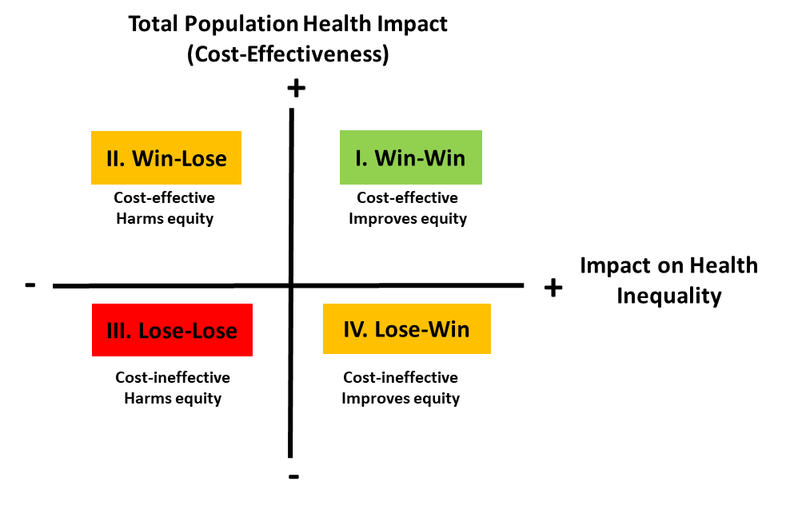
Equity/-Efficiency Impact Plane…Now what?
Notes:
Interventions in the North-East quadrant have both a positive impact on improving the distribution of health and on improving overall health and therefore represent a win-win. Interventions in the South-West quadrant are the opposite. For interventions in the North-West and South-East quadrants there is a trade-off required between the impact on equity and on total population health.

Slide 6
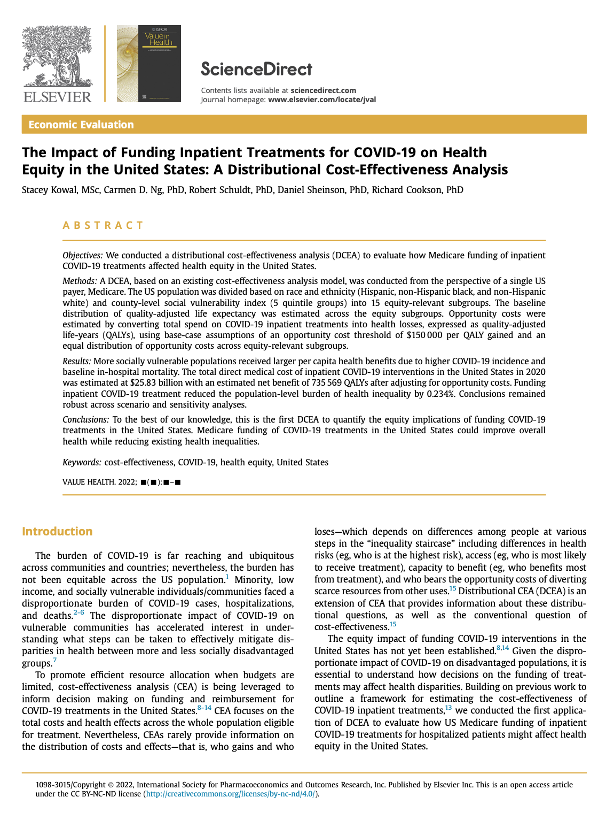
Illustrative Example:
US COVID-19 DCEA

Slide 7
Assessing Level of Vulnerability from Geography
Social vulnerability index measures relative social vulnerability for all US census tracts on 15 census variables
  SVI scores fall between 0 (least vulnerable) to 1 (most vulnerable)
A cross-sectional national study examining the relationship between social vulnerability and COVID-19 outcomes, shows: for every 0.1 increase in the SVI we see:¹
  14.3% relative increase in COVID-19 incidence
  13.7% relative increase in COVID-19 mortality
(1) Karmakar M, Lantz PM, Tipirneni R. Association of social and demographic factors with COVID-19 incidence and death rates in the US. JAMA network open. 2021 Jan 4;4(1):e2036462-.
Notes:
Karmarkar et al used a mixed effects negative binomial regression to model the COVID-19 case count. A mixed effects zero-inflated negative binomial regression was used to model death counts, since 29% of counties reported zero deaths. All cross sectional models included a random intercept for State.
Findings on the association of race/ethnicity and COVID-19 outcomes are highly variable^{1,2}
Increased COVID-19 risks commonly lose statistical significance when controlling for comorbid conditions, sex, age and place of residence^{3,4}
Social vulnerability index measures relative social vulnerability for all US census tracts on 15 census variables
SVI scores fall between 0 (least vulnerable) to 1 (most vulnerable)

Slide 8
Creating DCEA Subgroups for COVID-19 Inpatient Treatment
Least
vulnerable
Level of Social Vulnerability
Most vulnerable
Highest relative life expectancy
Quintile 1
Quintile 2
Quintile 3
Quintile 4
Quintile 5
Hispanic
Race/
Ethnicity
Quintile 1
Quintile 2
Quintile 3
Quintile 4
Quintile 5
White, non-Hispanic
Quintile 1
Quintile 2
Quintile 3
Quintile 4
Quintile 5
Black, non-Hispanic
Lowest relative life expectancy
Note: This study only captures a sample of the US given challenges with data missingness for other racial/ethnic groups, including but not limited to Asian/Pacific Islander, American Indian, Alaska Native, Asian Americans.
Notes:
Selection of race/ethnicity groups
important research given the observed higher relative burden of COVID-19 in these communities (CDC COVID-NET)
need to understand how differences in underlying life expectancy before COVID-19 impacts model outcomes
Differences in age make-up of population translate into different COVID-19 risks given the importance of age with COVID-19
Challenges with data missingness for other racial/ethnic groups within the US (including but not limited to Asian/Pacific Islander, American Indian, Alaska Native, Asian Americans)
Note that CDC wonder does include 31 race categories, but not all are well captured: White; Black; American Indian or Alaskan Native (AIAN); Asian; Native Hawaiian or Other Pacific Islander (NHOPI); Black and White; Black and AIAN; Black and Asian; Black and NHOPI; AIAN and White; AIAN and Asian; AIAN and NHOPI; Asian and White; Asian and NHOPI; NHOPI and White; Black, AIAN, and White; Black, AIAN, and Asian; Black, AIAN, and NHOPI; Black, Asian, and White; Black, Asian, and NHOPI; Black, NHOPI, and White; AIAN, Asian, and White; AIAN, NHOPI, and White; AIAN, Asian, and NHOPI; Asian, NHOPI, and White; Black, AIAN, Asian, and White; Black, AIAN, Asian, and NHOPI; Black, AIAN, NHOPI, and White; Black, Asian, NHOPI, and White; AIAN, Asian, NHOPI, and White; Black, AIAN, Asian, NHOPI, and White.

Slide 9
Insights from the Equity Staircase in COVID-19
Conventional CEA Focus
COVID-19 Patient in 20% Least Socially Vulnerable Portion of the Population²
40% lower risk of infection
38% lower risk of hospitalization
35% lower risk of inpatient mortality
Average US COVID-19 Patient (in 2020)¹
13.4% risk of infection
0.8% risk of hospitalization
21.5% risk of inpatient mortality*
COVID-19 Patient in 20% Most Socially Vulnerable Portion of the Population²
60% higher risk of infection
75% higher risk of hospitalization
45% higher of inpatient mortality
* represents average inpatient mortality across patients not on oxygen, on oxygen and on mechanical ventilation based on trends through the end of 2020 per the RECOVERY trial, the remdesivir clinical trial and US CDC MMWR reporting
1. Sheinson D, Dang J, Shah A, Meng Y, Elsea D, Kowal S. A Cost-Effectiveness Framework for COVID-19 Treatments for Hospitalized Patients in the United States. Advances in therapy. 2021 Apr;38(4):1811-31;.2. Kowal S, Ng CD, Schuldt R, Sheinson D, Cookson R. The Impact of Funding Inpatient Treatments for COVID-19 on Health Equity in the United States: A Distributional Cost-Effectiveness Analysis. Value in Health. 2022 Oct 1.
Notes:
Simple example of how health equity plays a role in many decisions represents a recent US HTA discussion with ICER on how a new treatment in multiple myeloma would impact health equity
We can do better; we can generate and use data to inform our understanding of health equity impacts

Slide 10
Overall Findings from COVID-19 DCEA
COVID-19 Patient in 20% Least Socially Vulnerable Portion of the Population
Fewer patients eligible for treatment Each patient treated gained 31% less health benefits
COVID-19 Patient in 20% Most Socially Vulnerable Portion of the Population
More patients eligible for treatment Each patient treated gained 37% more health benefits from treatment
Average US COVID-19 Patient (in 2020)
Health Equity
With assumed Atkinson parameter of 11,
inpatient COVID-19 treatments reduced
the population burden of health inequality by 0.234%
Total cost of COVID-19 inpatient treatments
in 2020 estimated at $25.83 billion
Population Health
Notes:
Scenario and sensitivity analyses
Opportunity cost thresholds of 50-150K
Atkinson parameters of 0 to 20
Opportunity costs taken from most, and least socially disadvantaged groups
100% variation in inpatient COVID-19 treatment costs

Slide 11

DCEA Applications in HTA
Clearly see equity-efficiency tradeoffs
Quantitatively consider the gains and opportunity cost losses from a decision
More clearly understand population subgroups that will benefit the most, or least
Understand how different population or health system factors influence equity
impacts
1
Leverage insights from the data collected to
populate a DCEA
How else can we leverage a DCEA in HTA?
2
Explore the value of new information to prioritize
future data collection for health equity research

Slide 12
Data from the Equity Staircase Provides Distributional Insights
LONG-TERM EFFECTS
Examples of differences to capture:
Timing of treatment initiation
Type of treatments used
Ability to access testing or treatment
SHORT-TERM EFFECTS
Examples of differences to capture:
Incidence/prevalence
Timing of diagnosis
Severity at diagnosis
Age at diagnosis
Examples of differences to capture:
Current outcomes under standard of care (i.e., higher inpatient mortality risk)
Impact of new treatments
RECEIPT
NEED
DCEA targeted literature review will capture important differences across equity-relevant subgroups, which are commonly defined by geographic deprivation measures and/or race and ethnicity

Slide 13
How is this useful outside of the DCEA results?
Synthesized Data from a DCEA Can Inform Intervention Planning:
Where to target interventions: We know the locations where the most vulnerable patient reside (US counties)
How to target interventions: Customize the DCEA to reflect local conditions (i.e., US States) or planned intervention/public health strategies
  You can track progress of your intervention by updating your analysis to see the impact (i.e., impact of x% more screened)
COVID-19 Patient in 20% Most Socially Vulnerable Portion of the Population¹
60% higher risk of infection
75% higher risk of hospitalization
45% higher of inpatient mortality
When to best intervene: Identify where (and why) in the patient journey differences in prevalence or access are driving inequitable outcomes in care
1. Kowal S, Ng CD, Schuldt R, Sheinson D, Cookson R. The Impact of Funding Inpatient Treatments for COVID-19 on Health Equity in the United States: A Distributional Cost-Effectiveness Analysis. Value in Health. 2022 Oct 1.
Notes:
Simple example of how health equity plays a role in many decisions represents a recent US HTA discussion with ICER on how a new treatment in multiple myeloma would impact health equity
We can do better; we can generate and use data to inform our understanding of health equity impacts
In socially vulnerable countries there were more cases, more hospitalizations, more inpatient mortality → inpatient hospitalization is key intervention step to address inequitable care outcomes

Slide 14
Many Settings Lack Foundational DCEA Data
Describe Pre-Decision Health Inequalities
Evaluate Intervention Impacts on Health Inequality (Health Benefits)
Estimate Population Outcomes for Each Subgroup
Assess Equity
Impact to the Population Overall
1
2
3
4
Measure Current Health Equity in the Population^{1,2}
Equity-Informative Cost-Effectiveness
Analysis Methods
Standard HEOR Methods for CEA
Understand Health
Inequality Aversion³
Subgroup Data from Real World Evidence and Inclusive Trials
Data gaps are most critical for use of DCEA for HTA, where the decision looks into the future
1. Love-Koh J, Asaria M, Cookson R, Griffin S. The social distribution of health: estimating quality-adjusted life expectancy in England. Value in health. 2015 Jul 1;18(5):655-62; 2. Cookson R, Propper C, Asaria M, Raine R. Socio‐economic inequalities in health care in England. Fiscal studies. 2016 Sep;37(3-4):371-403. 3. Robson M, Asaria M, Cookson R, Tsuchiya A, Ali S. Eliciting the level of health inequality aversion in England. Health economics. 2017 Oct;26(10):1328-34.
Notes:
The United Kingdom has completed these steps and is in the process of considering how - and where - to incorporate equity considerations into the HTA process. Other countries making similar progress include Chile, Australia, Japan, Thailand and Singapore

Slide 15
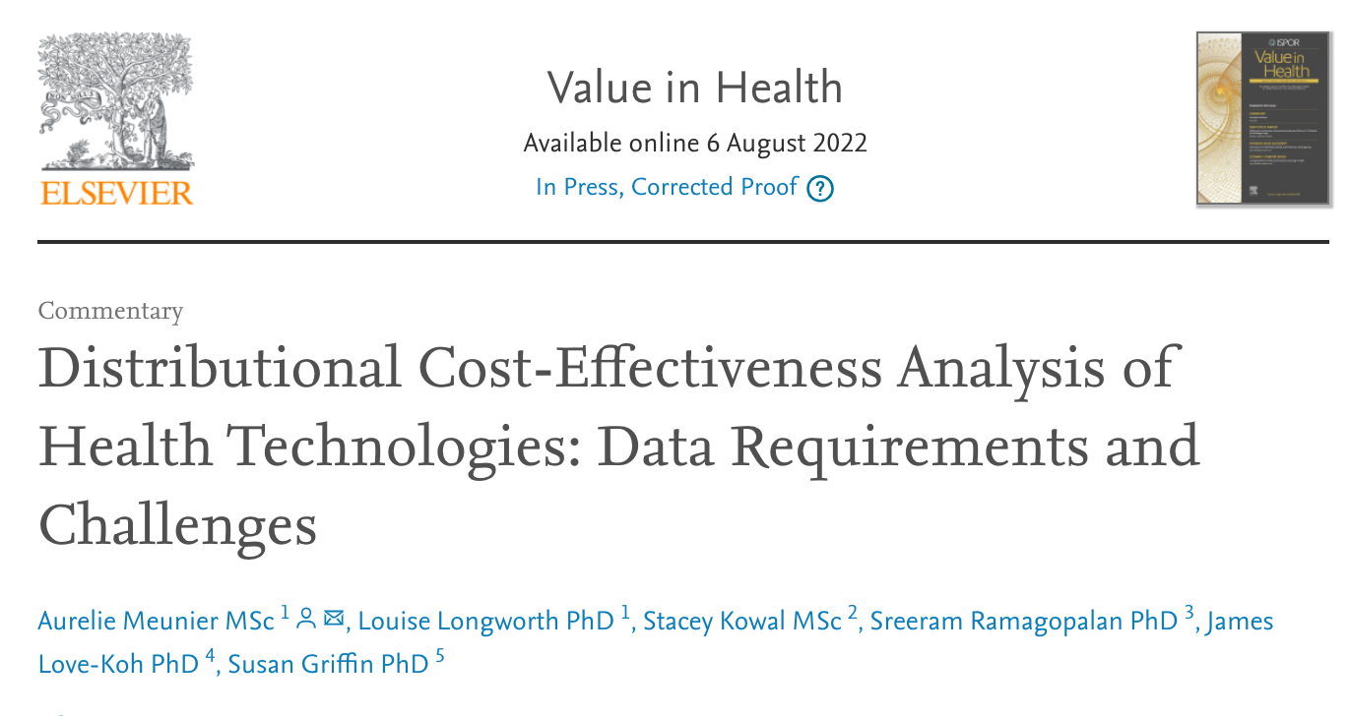
Distributional Information is not Routinely Collected
DATA
LONG-TERM EFFECTS
SHORT-TERM EFFECTS
RECEIPT
NEED

Slide 16
Ways to Support Improved Data for Health Equity Research
DCEA to Prioritize Data Gathering
Stakeholder Actions Beyond DCEA
Synthesize available distributional data
Clearly define equity concerns
  Informs equity-relevant subgroups
  Guides data enrichment and data generation
Recommend criteria or indices (i.e., deprivation measures) to identify subgroups and stratify the population
Establish current best practices and/or roadmaps for equity considerations in HTA (or broader decision-making)
Identify accountable stakeholders
Highlight important data gaps in the equity staircase
Leverage imperfect/anecdotal information to fill gaps and to examine importance of improved data
Scenario testing to prioritize data needed

Slide 17
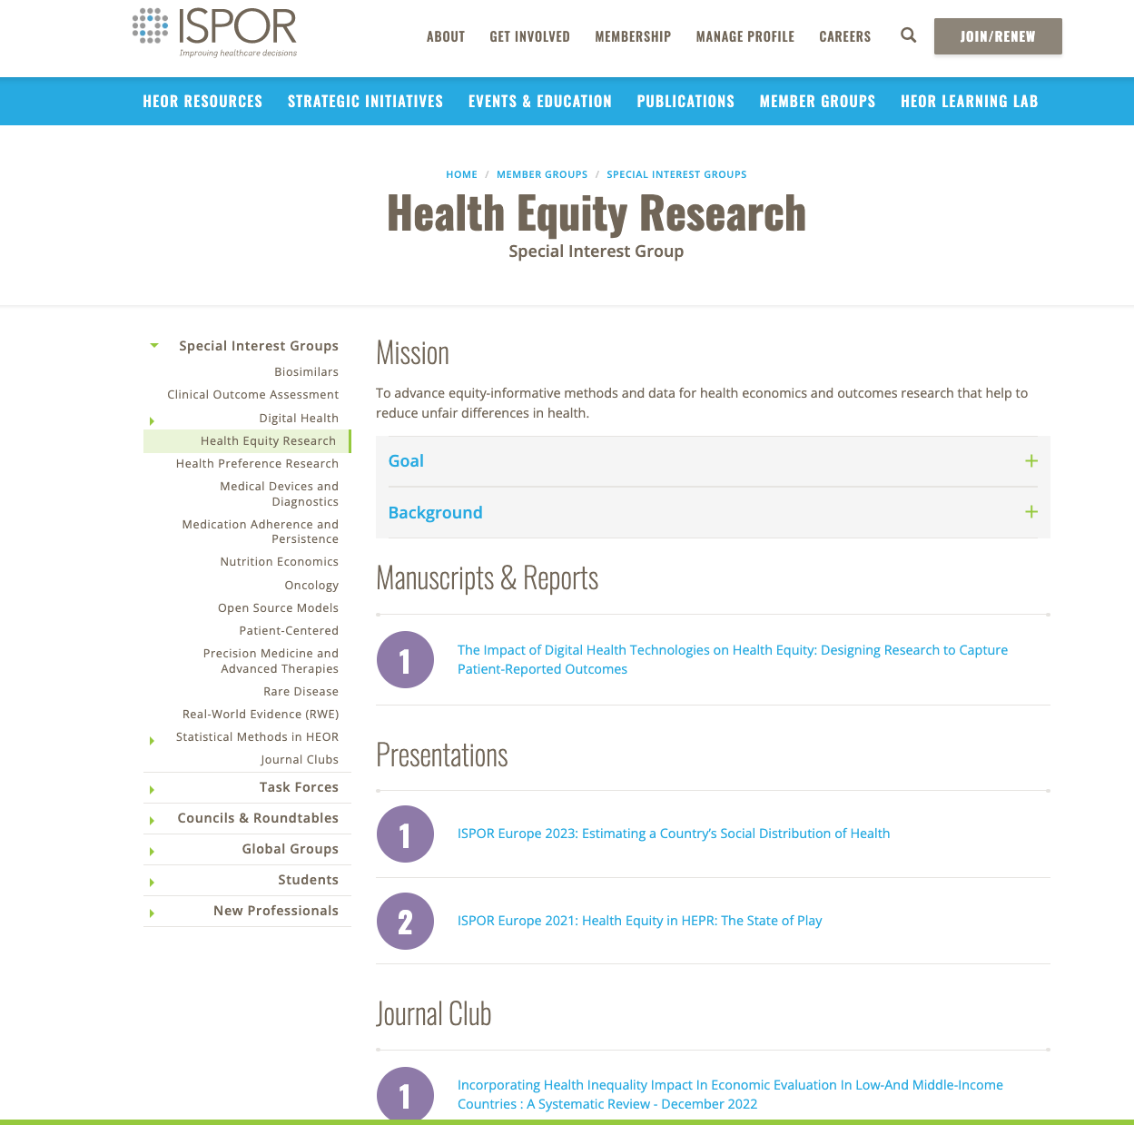

Check out the ISPOR Health Equity SIG!
SIG Email:
HealthEquitySIG@ispor.org
SIG Website:
https://www.ispor.org/member-groups/special-interest-groups/health-equity-research

