Slide 1

Use of Health Equity Research in Decision Making:
The State of Play
Professor Richard Cookson
Centre for Health Economics
University of York

Slide 2
Audience Poll
Is your country/jurisdiction working on generating the evidence and methods to measure and report on health inequality impacts routinely?
  Yes
  No
  I don’t know

Slide 3


Slide 5
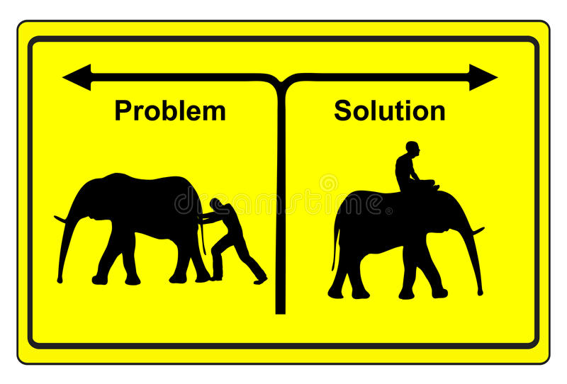
Describing Problems vs. Evaluating Solutions
Cost of Illness
Burden of Illness
Health Inequality
Intervention IMPACT on Cost of Illness
Intervention IMPACT on Burden of Illness
Intervention IMPACT on Health Inequality

Slide 6

Illustration by Marcia Staimer

Slide 7
When and by whom could equity information be used?
R&D decision making by industry
Payer decision making about reimbursement and clinical guidance
  Topic selection
  Scoping
  Guidance development
  Implementation

Slide 8
What Could Be Done…
A. Sometimes vs. Routinely
B. Based on Evidence and Analysis vs. Expert Opinion
C. Using Disease-Specific vs. Generic Equity Outcomes
Describe Pre-Decision Health Inequalities
  Unfair differences in health by socioeconomic status, ethnicity, location and other aspects of social disadvantage
Evaluate Intervention Impacts on Inequality in Health Benefits
  Distribution of health benefits, which depends on differences in (1) eligible population, (2) uptake, (3) health effects
Evaluate Overall Intervention Impacts on Health Inequalities
  Direction and magnitude of impact on health inequalities, allowing for the distribution of health opportunity costs as well as health benefits
Evaluate Equity-Efficiency Trade-Offs Between Reducing Health Inequalities and Improving Health
  Is it worth funding an intervention that is not cost-effective but reduces health inequality? Is it worth funding an intervention that is cost-effective but increases health inequality? How far should the standard cost-effectiveness test be modified for interventions which increase or reduce health inequality?
Evaluate Equity-Equity Conflicts Between Prioritising the Severely Ill and Reducing Health Inequalities
  Is it worth funding a treatment for patients who are currently severely ill even if it increases health inequalities? Is it worth funding a preventive intervention that reduces health inequalities even if it benefits people who are not currently severely ill?

Slide 9
The Staircase of Inequality
Health Opportunity Cost (*)
Social inequalities may arise at different steps on the health intervention pathway,
with different impacts on health inequality
Effectiveness
RCTs can potentially provide sub-group analysis information on social differences in uptake and effectiveness, if samples are inclusive and data are collected
Uptake
Eligible Population
(*) Health loss due to intervention costs: scarce resources would otherwise be used to improve health in other ways.

Slide 10
Equity-Efficiency Impact Plane
Total Population Health Impact
(Cost-Effectiveness)
Currently, decision makers focus on the vertical axis:
cost-effectiveness and impact on total population health.
The horizontal axis is missing.
+
II. Win-Lose
I. Win-Win
Cost-effective
Harms equity
Cost-effective
Improves equity
-
Impact on Health
Equity
+
III. Lose-Lose
IV. Lose-Win
Cost-ineffective
Harms equity
Cost-ineffective
Improves equity
-

Slide 11
Simplified or “aggregate” DCEA
Simplified DCEA allows health economists to produce a quick and simple “what if” estimate of the overall health inequality impact of a recommendation using their own cost-effectiveness data inputs and assumptions.
For example, to calculate the overall impact on social inequality in health in England by five socioeconomic groups, based on the neighbourhood-level index of multiple deprivation (IMD).
It does not conduct detailed modelling and it usually focuses on a small number of groups rather than breaking things down further (e.g. by regional deprivation, ethnicity, gender, disability, rough sleeping, drug use, imprisonment, other vulnerable and excluded populations).

Slide 12
Audience Poll
Has health inequalities influenced an HTA/reimbursement decision in your country?
  Yes
  No
  Only in special circumstances,
  Yes, but only based on disease characteristics (e.g., severe and rare disease)
  I don’t know

Slide 13
Equity-equity conflicts
Health inequality vs. current severity
Current severity concern typically prioritises acute care for older populations with late stage disease.
Health inequality concern typically priorities primary care for younger populations with early stage disease or risk factors.
e.g. Is it fairer to prioritise (1) a new drug for late stage skin cancer or (2) screening for maternal depression?
Current severity of illness
  Priority to late stage skin cancer
  Very short life expectancy (“end-of-life”)
Health inequality
  Priority to maternal screening
  Babies with depressed mothers can expect below-average lifetime health and social status
  Most skin cancer deaths occur age 70+ among people with above-average social status

Slide 14
What Is Currently Done
Describe Pre-Decision Health Inequalities
  Sometimes, but not using generic equity metrics (e.g. contribution to overall inequality in expected lifetime health)
Evaluate Intervention Impacts on Health Inequalities
  Never based on evidence and analysis
  Sometimes using explicit expert opinion (e.g. MCDA)
Evaluate Equity-Efficiency Trade-Offs
  Never based on evidence and analysis
  Sometimes using explicit expert opinion (e.g. MCDA)
Evaluate Equity-Equity Conflicts
  Never explicitly analysed – only implicit value judgements

Slide 15

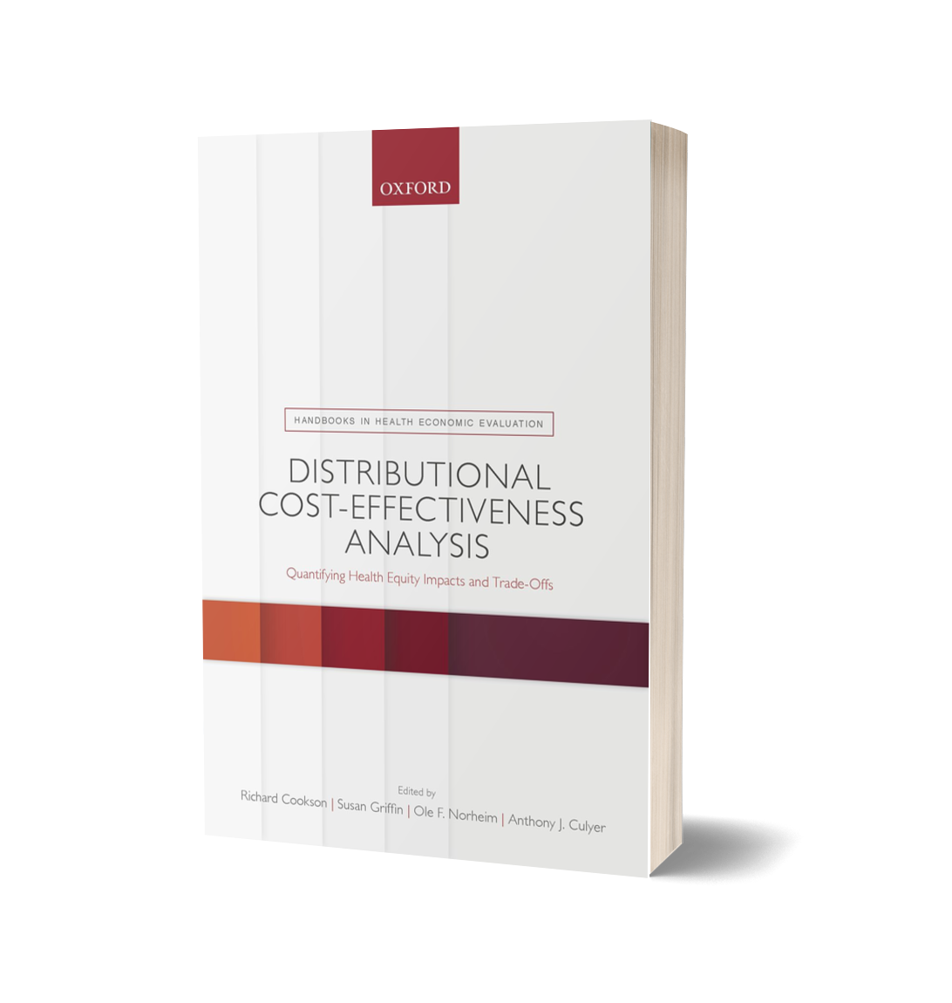
DISTRIBUTIONAL
COST-EFFECTIVENESS ANALYSIS
Quantifying Health Equity Impacts and Trade-Offs
An Oxford University Press
Handbook in Health Economic Evaluation
Edited by Richard Cookson, Susan Griffin, Ole F. Norheim, and Anthony J. Culyer
Flexible methods for any decision context
Practical spreadsheet training exercises
Clear overview for decision-makers
‘The definitive guide to equity methods in health economic evaluation - a landmark in the field.’
  Michael Drummond, Professor of Health Economics, University of York, UK
https://www.york.ac.uk/che/publications/books/handbook-dcea/

Slide 16
Readings
Cookson, Richard Andrew , Griffin, Susan , Norheim, Ole F, Culyer, A J and Chalkidou, K. (2020). Distributional Cost-Effectiveness Analysis Comes of Age. Value in Health. https://doi.org/10.1016/j.jval.2020.10.001
Cookson, R., A. J. Mirelman, S. Griffin, M. Asaria, B. Dawkins, O. F. Norheim, S. Verguet and A. J. Culyer (2017). "Using Cost-Effectiveness Analysis to Address Health Equity Concerns." Value in Health 20(2): 206-212. DOI: https://doi.org/10.1016/j.jval.2016.11.027
Asaria, M, Griffin, S and Cookson, R. (2016). "Distributional Cost-Effectiveness Analysis: A Tutorial." Medical Decision Making 36(1): 8-19. http://mdm.sagepub.com/content/36/1/8.abstract
Love-Koh, J., Cookson, R., Gutacker, N., Patton, T., Griffin, S., 2019. Aggregate Distributional Cost-Effectiveness Analysis of Health Technologies. Value in Health, 22(5), 518–526. [Link]
Robson M, Asaria M, Cookson R, Tsuchiya A, Ali S (2017) Eliciting the level of health inequality aversion in England Health Economics 26(10): 1328–1334 http://onlinelibrary.wiley.com/doi/10.1002/hec.3430/full

Slide 17
Audience Poll
What topic would you most like to learn more about in the future:
How to describe pre-decision health inequalities
How to evaluate intervention impacts on inequality in health benefits
How to evaluate overall intervention impacts on health inequalities, including consideration of opportunity costs
How to evaluate equity-efficiency tradeoffs
How to evaluate equity-equity conflicts

Slide 18
Thank you

Slide 19
Health Equity Research in HEOR in Latinamerica
Dr. Manuel Espinoza S., MD MSc PhD
Associate Professor - Department of Public Health
Chief – Health Technology Assesment Unit (ETESA-UC)
Faculty of Medicine
Editor in Chief – Value in Health Regional Issues

Slide 20
State of health equity research in HEOR in LATAM
What could be done? | Has it been done? Yes/no | Examples
Describe pre-decision health inequalities | ✓ | Strong interest in the region for Universal Health coverage, which has led to many researchers to describe the status of the distribution of Access to healthcare as well as health outcomes
Evaluate intervention impacts on inequality in Health Benefits | ✓/✗ | Very few studies exploring intervention´s effect in subgroups defined by socioeconomic status or location
Evaluate overall intervention impacts on Health inequalities | ✗ | Ongoing, a DCEA analysis in technologies for diabetes mellitus
Evaluate equity- efficiency trade-offs between reducing health inequalities and improving health | ✗
Evaluate equity-equity conflicts between prioritising the severely ill and reducing health inequalities | ✓ | Dominican Republic (2015): MCDA revealed preferences between severity, equity in access and geographical equity. Argentina (2021): using MCDA to reveal preferences between severity, equity in access and equity in health

Slide 21
Challenges
Decision making of healthcare technologies informed by formal health technology assessment processes have been institutionalized in few countries of LATAM.
However, in most countries equity is a major attribute, highly valuable, to inform decisions in healthcare
Professional technical capacity has grown significantly in the last decade in LATAM, mostly in academia or specialized centres.
The main two challeges are: (1) Access to good data (heterogeneous across the region); and (2) lack of institutional capacities in the health system to use the evidence.
Notes:
Even in countries where there are technical capacities in decisión making bodies, the institutional arrangement is highly dependent on political power and this evidence may not be relevant if is not aligned with the political will.

Slide 22
Audience Poll
Is it worth funding an intervention that is not cost-effective but reduces health inequality?
Yes
No
Only in special circumstances

Slide 23
Health Equity in HEOR:
Perspectives from Southeast Asia
Diana Beatriz Bayani
Saw Swee Hock School of Public Health
National University of Singapore
Notes:
Describing problems or evaluating solutions
Subgroup trials and report difference in trials and uptake

Slide 24
The State of Play
Notes:
Blank slide – not much has been done in terms of actual research.
HTA experience in the region is quite varied. Some countries have just started while some have been successfully implementing HTA for decision-making for over 10 years.
Do we quantitively evaluate intervention impact on health inequalities? Direction and magnitude of effects based on differences in population, uptake, health effects, health opportunity costs? Look at equity-efficiency trade-offs? So far, no, not yet. Right now, focus is on describing the health inequities, although some have tried to address the inequity on case by case basis (not in an explicit process like HTA).

Slide 25
Equity Considerations in HTA: Thailand
Topic nomination by multiple stakeholders including lay people, civil society, and patient organizations
Prioritization of proposed interventions through MCDA and deliberation
Implicit consideration of the distribution of health effects in the evaluation and appraisal
Tantivess S, Doungthipsirikul S (2019). Leaving No One Behind: Participatory Technology Appraisal as a Platform for Agenda Setting to Address Disparities in Access to Health Services in Thailand. International Journal of Technology Assessment in Health Care 1–6.
Sripen Tantivess, Román Pérez Velasco, Jomkwan Yothasamut, Adun Mohara, Hatai Limprayoonyong, Yot Teerawattananon, (2012),"Efficiency or equity: value judgments in coverage decisions in Thailand", Journal of Health Organization and Management, Vol. 26 Iss: 3 pp. 331 – 342
Leelahavarong P, Doungthipsirikul S, Kumluang S, Poonchai A, Kittiratchakool N, Chinnacom D, Suchonwanich N, Tantivess S (2019). Health Technology Assessment in Thailand: Institutionalization and Contribution to Healthcare Decision Making: Review of Literature. International Journal of Technology Assessment in Health Care 35, 467–473
Notes:
Example of evidence base: absorbent products for disabled → considerable increase in QoL for most vulnerable group

Slide 26
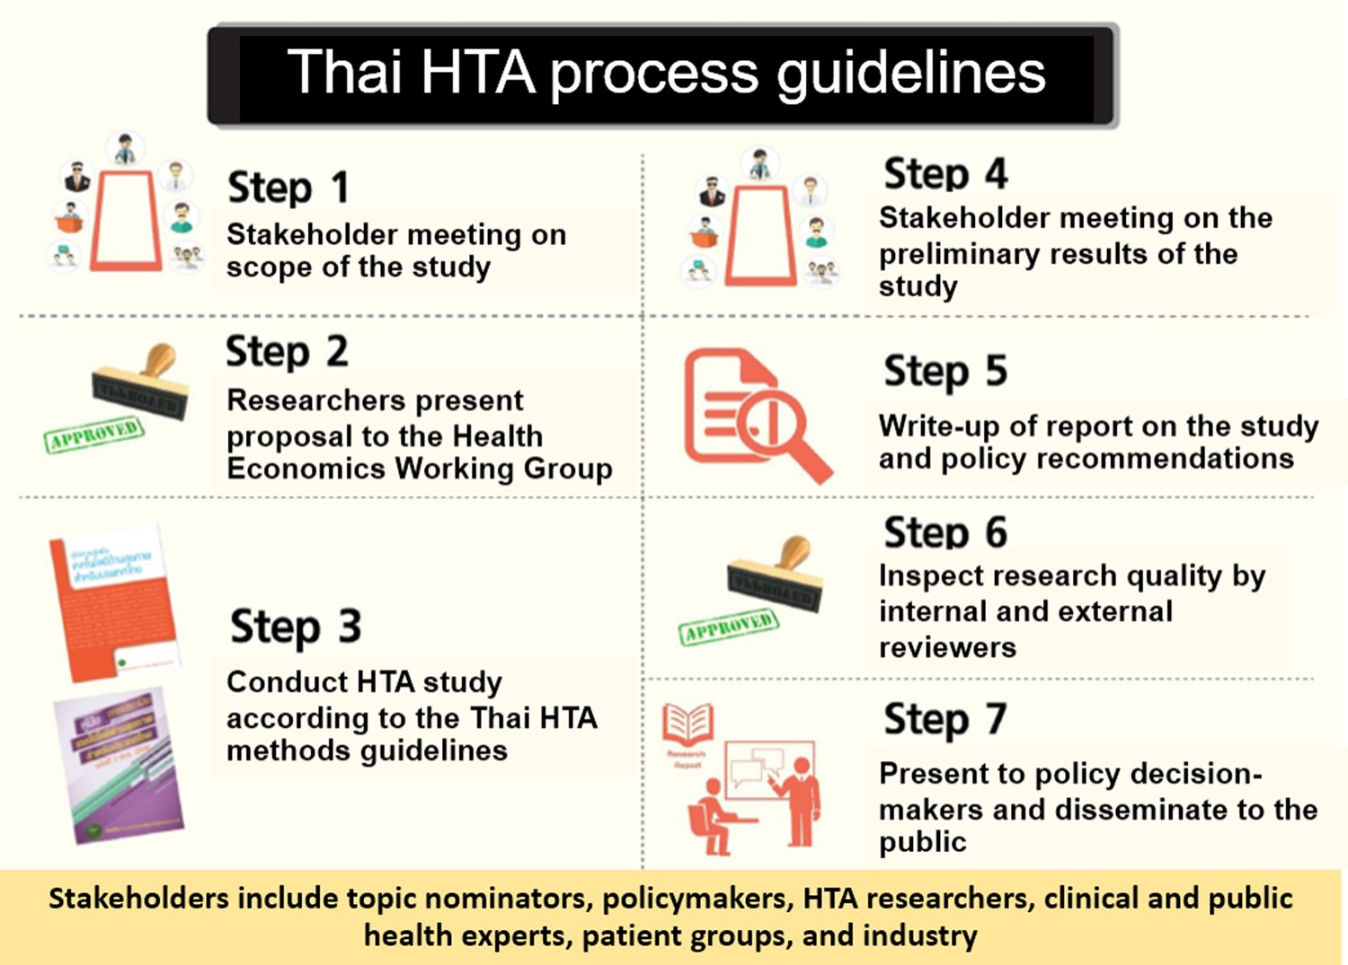
Notes:
Equity considerations in the HTA process, but not so much in the technology appraisal methods. Ethics arguments among policymakers and stakeholders could be observed in every stage of the benefit package development; however, the deliberations were not assessed systematically, and the influence of these arguments on policymaking relied on subjective analysis.

Slide 27

Equity Considerations in HTA: Philippines
Ethical analysis as a required section of an HTA report
  Use of qualitative methods to assess distribution of outcomes based on socioeconomic status, gender, ethnicity and religion
  At the most basic level, a description of particular groups which may be disproportionately affected by a decision should be provided
  Consider use of PROGRESS-Plus to stratify health opportunity costs and outcomes and EUPATI ELSE checklist
Philippine HTA Methods Guide, First Edition. Department of Health Philippines 2020.
Notes:
Qualitative methods suggested: participant observation, in-depth interviews, FGDs, online ethnography
PROGRESS-Plus: place of residence, race, occupation, gender, religion, education, socioeconomic status, social capital, Plus

Slide 28
Plans for future work
Conduct of the first full DCEA in the region and related studies for a specific disease-intervention pair
  Estimating the baseline health distribution in Thailand
  Modelling distribution of intervention costs and effects
  Health inequality impact and trade-off analysis
  Assessment of feasibility of using DCEA to inform decision making in the region
Notes:
Covid has spurred new national drives to reduce health inequality + new methods for DCEA (to work in collaboration with Uni of York)
Start with Thailand which has the most experience in HTA in the region and where data is available using Hep C example
Equity issues are always political concerns in LMICs (given the gap we all have) and equity or inequity issues have been used in HTA topic selection and assessment though there are standardised way to incorporate this evidence in CEA. DCEA has good potential and is worthwhile to be tested in policy decision making in LMICs. Our only concern about DCEA is whether it is feasible in research and understandable by decision makers and the public.

Slide 29
Audience Poll
Does your country/jurisdiction have information available on baseline levels of health inequity?
Yes
No
I don’t know

Slide 30
Health Equity Research in HEOR in North America
Stacey Kowal
Chair, Health Equity Research Special Interest Group
Principal Researcher, Health Policy and Systems Research
Genentech, Inc
Kowal.Stacey@gene.com

Slide 31


Within US HEOR, we are just starting to make progress on how we want to measure, value and communicate equity impacts
Current State of Play – Growing Recognized Importance of Health Equity
Inclusive clinical trials
Policy focus on health equity
D&I efforts within and across companies
Increased HTA focus on equity issues
Raising awareness around clinical trial representativeness
Health Improvement Distribution Index
Equity-related voting questions
Webinar series on health equity (policy, methods, action)
Notes:
From ICER:
Raising awareness around the representativeness (or lack thereof) of trial populations versus clinical practice surrounding disadvantaged populations
This often comes up in ICER’s policy recommendations
Piloting the Health Improvement Distribution Index (asthma draft report, diabetes draft report – available next week, and other future assessments)
Equity-related voting questions

Slide 32
At present, the US does not measure and consider equity information consistently and we rely mostly on expert opinion for interpretation
What could be done? | Has it been done? | Examples
Describe pre-decision health inequalities | Yes (But..) | Targeted disease-specific or geography-specific studies Ongoing work to map health inequalities with existing data Ongoing work to address key gaps and fully map health inequalities for the US
Evaluate intervention impacts on inequalities in Health Benefits | Yes (But..) | Analyses of impact of race and ethnicity and social determinants of health on health outcomes Equity analysis through simple comparisons or changes in disparity indexes, largely applied to public health programs^{1,2} Ongoing work to create DCEA of COVID-19 treatments
Evaluate equity- efficiency trade-offs between reducing health inequalities and improving health | Yes (But…) | General discussion based on expert opinion
Evaluate equity-equity conflicts between prioritising the severely ill and reducing health inequalities | No | General discussion based on expert opinion
DCEA: Distributional cost-effectiveness analysis
1.) Quan AM, Mah C, Krebs E, Zang X, Chen S, Althoff K, Armstrong W, Behrends CN, Dombrowski JC, Enns E, Feaster DJ. Improving health equity and ending the HIV epidemic in the USA: a distributional cost-effectiveness analysis in six cities. The Lancet HIV. 2021 Sep 1;8(9):e581-9l;
2. Avanceña AL, Prosser LA. Examining Equity Effects of Health Interventions in Cost-Effectiveness Analysis: A Systematic Review. Value in Health. 2020 Dec 3

Slide 33
Existing data and methods can support increased used of equity-informative HEOR, but there is still work to be done
US Readiness for Equity-Informative CEA
Describe Pre-Decision Health Inequalities
Evaluate Intervention Impacts on Health Inequalities
Evaluate Equity-Efficiency Trade-Offs
Evaluate Equity-Equity Conflicts
Existing Data & Methods Ready Today
Robust US panel data on life expectancy and disability
Nationally representative data on population size by race and ethnicity
Aggregate measures of deprivation and vulnerability (e.g. area deprivation index, social vulnerability index, social deprivation index)
Standard tests of dominance or direct outcome weighting
Scenario analyses with social welfare functions
Next Steps to Enhance US Application
Missing mortality data for small counties and many racial and ethnic populations
Limited information on within county heterogeneity
RWE on outcomes across heterogeneous population subgroups
Information on medical spending across equity-relevant groups
Understanding US preferences for inequality aversion
Understanding US preferences equity-equity tradeoffs (e.g., MCDA)
Key Gaps for Expanded US Use
Missing QALY data by geography and race and ethnicity
Determining how we value equity/efficiency tradeoffs in healthcare decisions
HTA, payer, or policy guidance on how to address these tradeoffs
RCT data on treatment effects in subgroups
QALY: quality-adjusted life years; RWE: real world evidence; RCT: randomized controlled trial: MCDA: multi-criteria decision analysis; HTA: health technology assessment

Slide 34
Audience Poll
Do you think we can start to more formally consider equity impacts now, even while data is being generated to inform more empiric estimates?
Yes
No
Only in special circumstances

Slide 35
Health Equity Research SIG– Check us out and join!
Proposed Mission: To advance equity-informative methods of health economics and outcomes research that help to measure, address, and reduce health disparities
KEY RESEARCH QUESTION
How would US government (i.e., Medicare) funding of inpatient treatments for COVID-19 impact current underlying health disparities in the United States?
Advance novel methods for assessing health equity impacts, including application of equity-informative cost-effectiveness analysis across markets, conditions, and payer types
Establish a forum for members to engage in discussion related to the challenges of measuring and addressing health disparities in HEOR and healthcare decision making
Foster multi-stakeholder dialogue between policy makers, regulators, payers, advocacy groups, prescribers, patients, and researchers about health equity considerations at all stages of decision making, from inclusive clinical trials through health technology assessment (HTA) and implementation.
Improve data sources used by the HEOR community to study health inequities

